Slide 1



Cyber Attacks
Part 2
Notes:
13. **Cyber Attacks (30 mins)**
- Many core topics revolve around attacks. We would combine this all under Hacking and Cyber Attacks, initially beginning with an introduction, followed by analysing case studies for Brute Force Attacks and DDoS Attacks.
- Topics:
- Hacking and Cyber Attacks
- Brute Force Attacks
- DDoS Attacks
14. **Buffer Overflows (30 mins)**
- This lecture will cover Buffer Overflows and issues faced with memory. There will be a short reminder about SQL injections.
- Topics:
- Buffer Overflows
- Memory Issues
- SQL Injections
15. **Malware and Viruses (30 mins)**
- This is similar to the previous area but involves much more detail. Thus, I suggest more time dedicated to this. Malware discussed would be logic bombs, backdoors, viruses, supply chain tracks, Trojan horses and worms.
- Topics:
- Malware and Viruses
- Logic Bombs
- Backdoors
- Viruses
- Supply Chain Attacks
- Trojan Horses
- Worms
16. **Threat-Vectors and Threat Agents (30 mins)**
- Vector-based threats involve Cross-Site Scripting, Insider Threats, and Social Engineering. Agent-based threats involve Hacktivists, Script Kiddies, Cyber Crime Gangs, and Black-and-White Hat Hackers.
- Topics:
- Vector-Based Threats
- Agent-Based Threats
- Cross-Site Scripting
- Insider Threats
- Social Engineering
- Hacktivists
- Script Kiddies
- Cyber Crime Gangs
- Black-and-White Hat Hackers

Slide 2
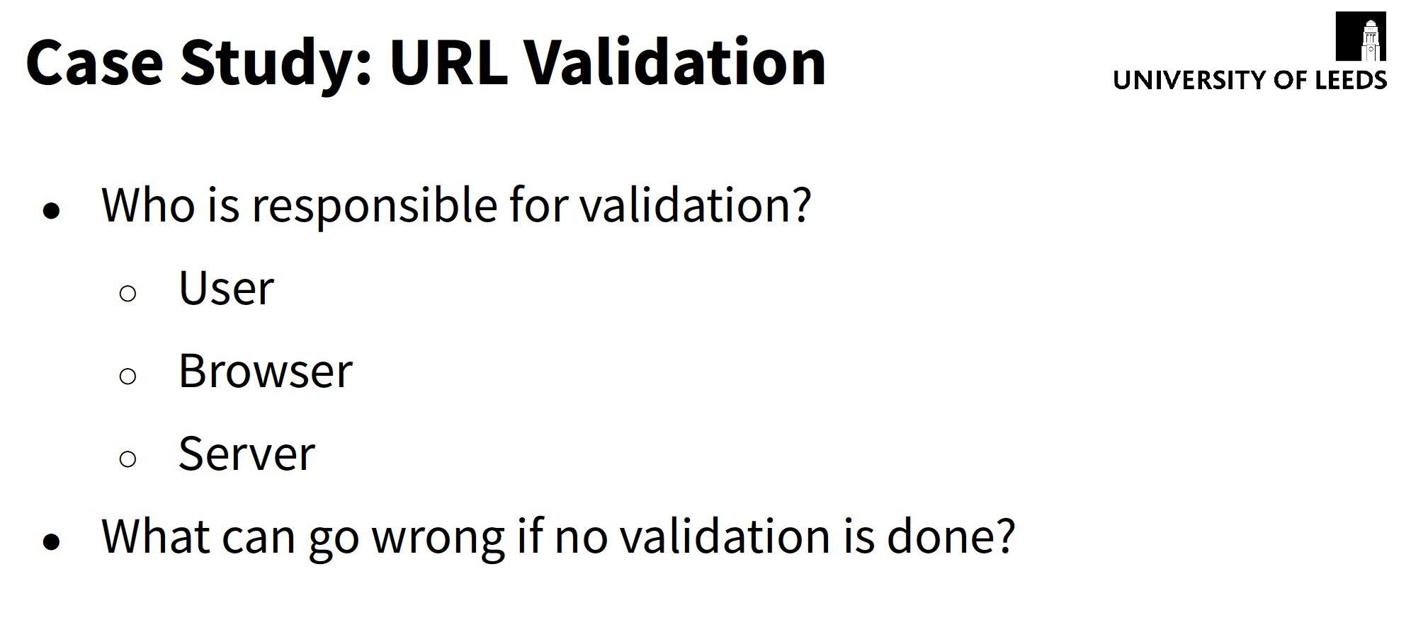

Slide 3
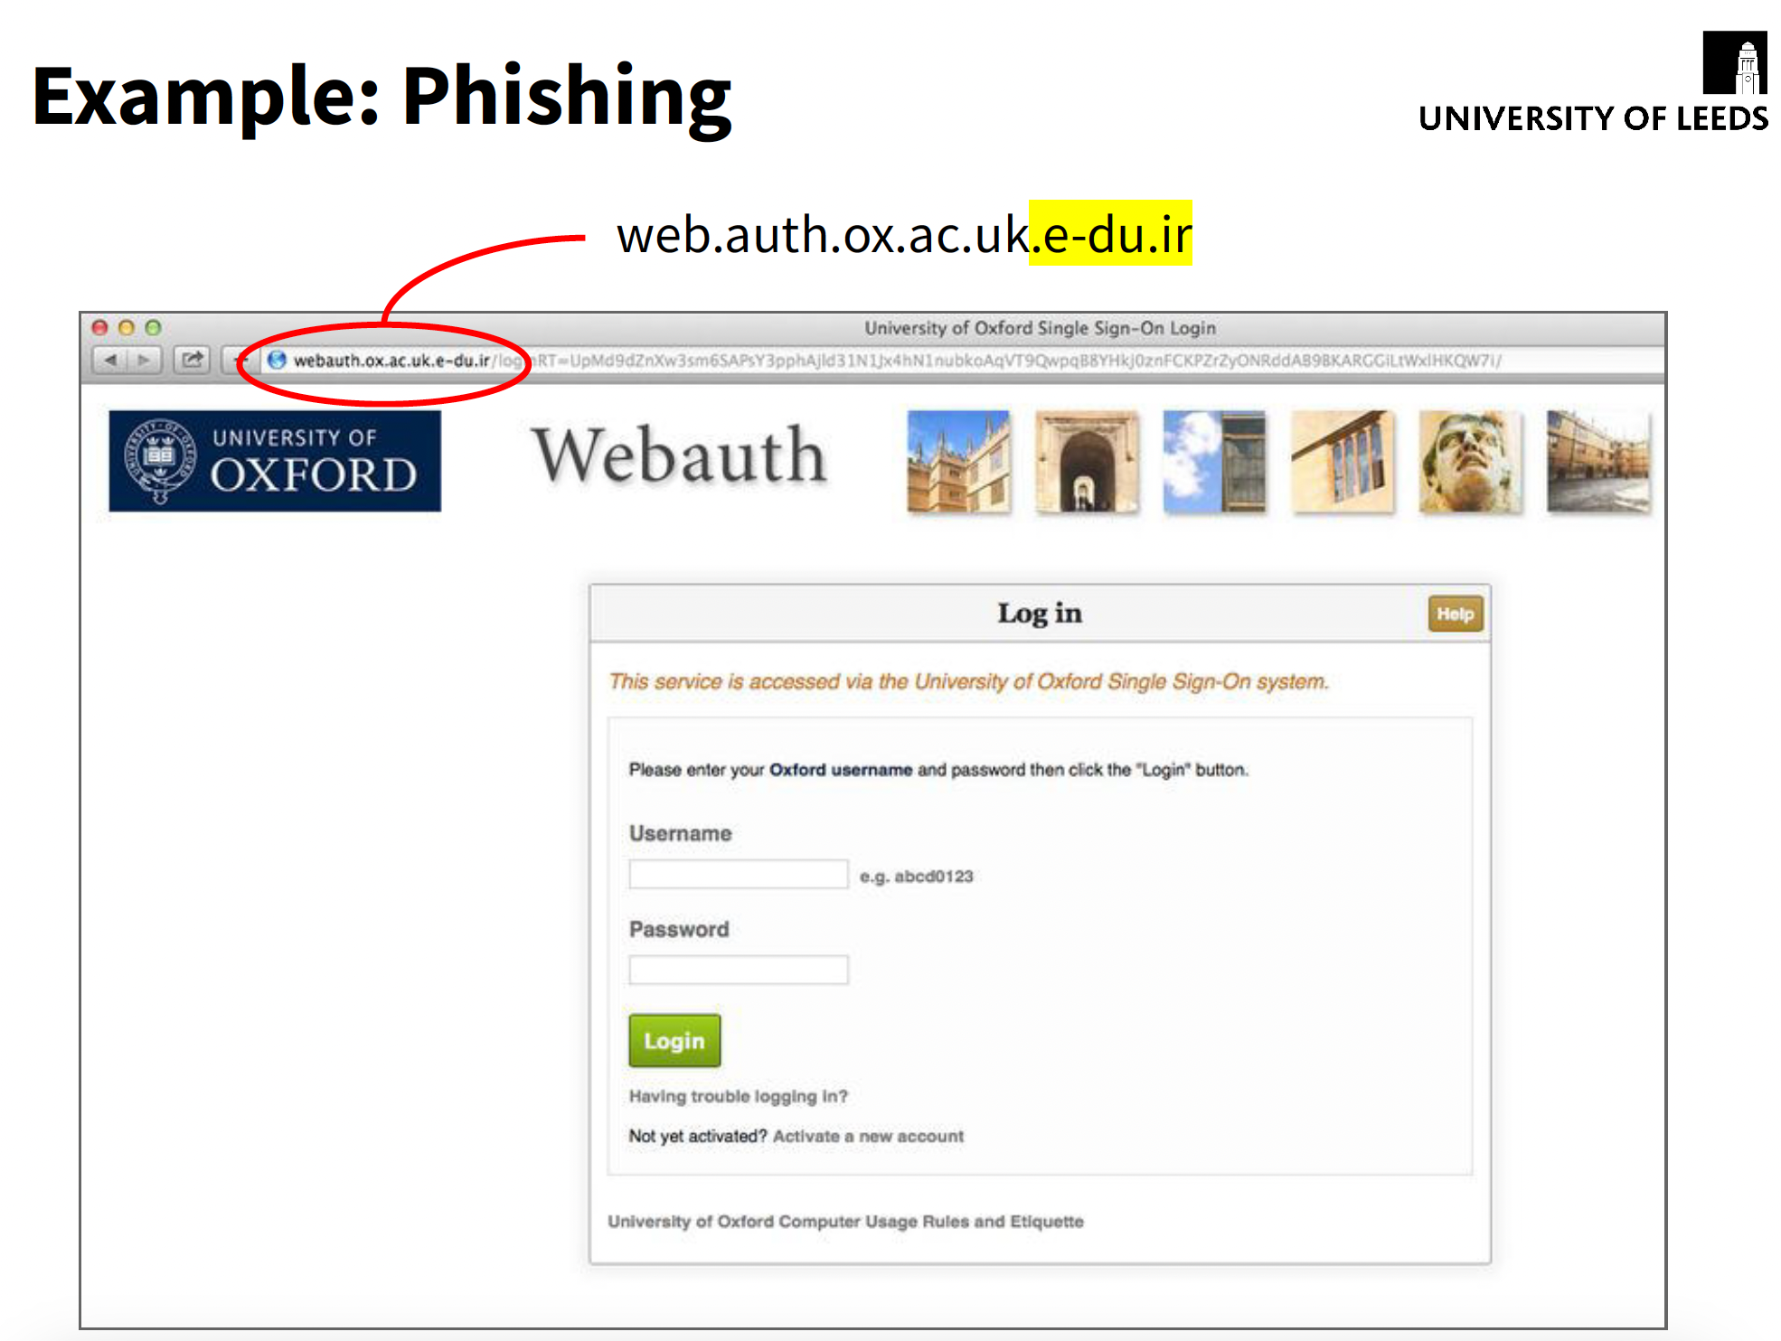

Slide 4
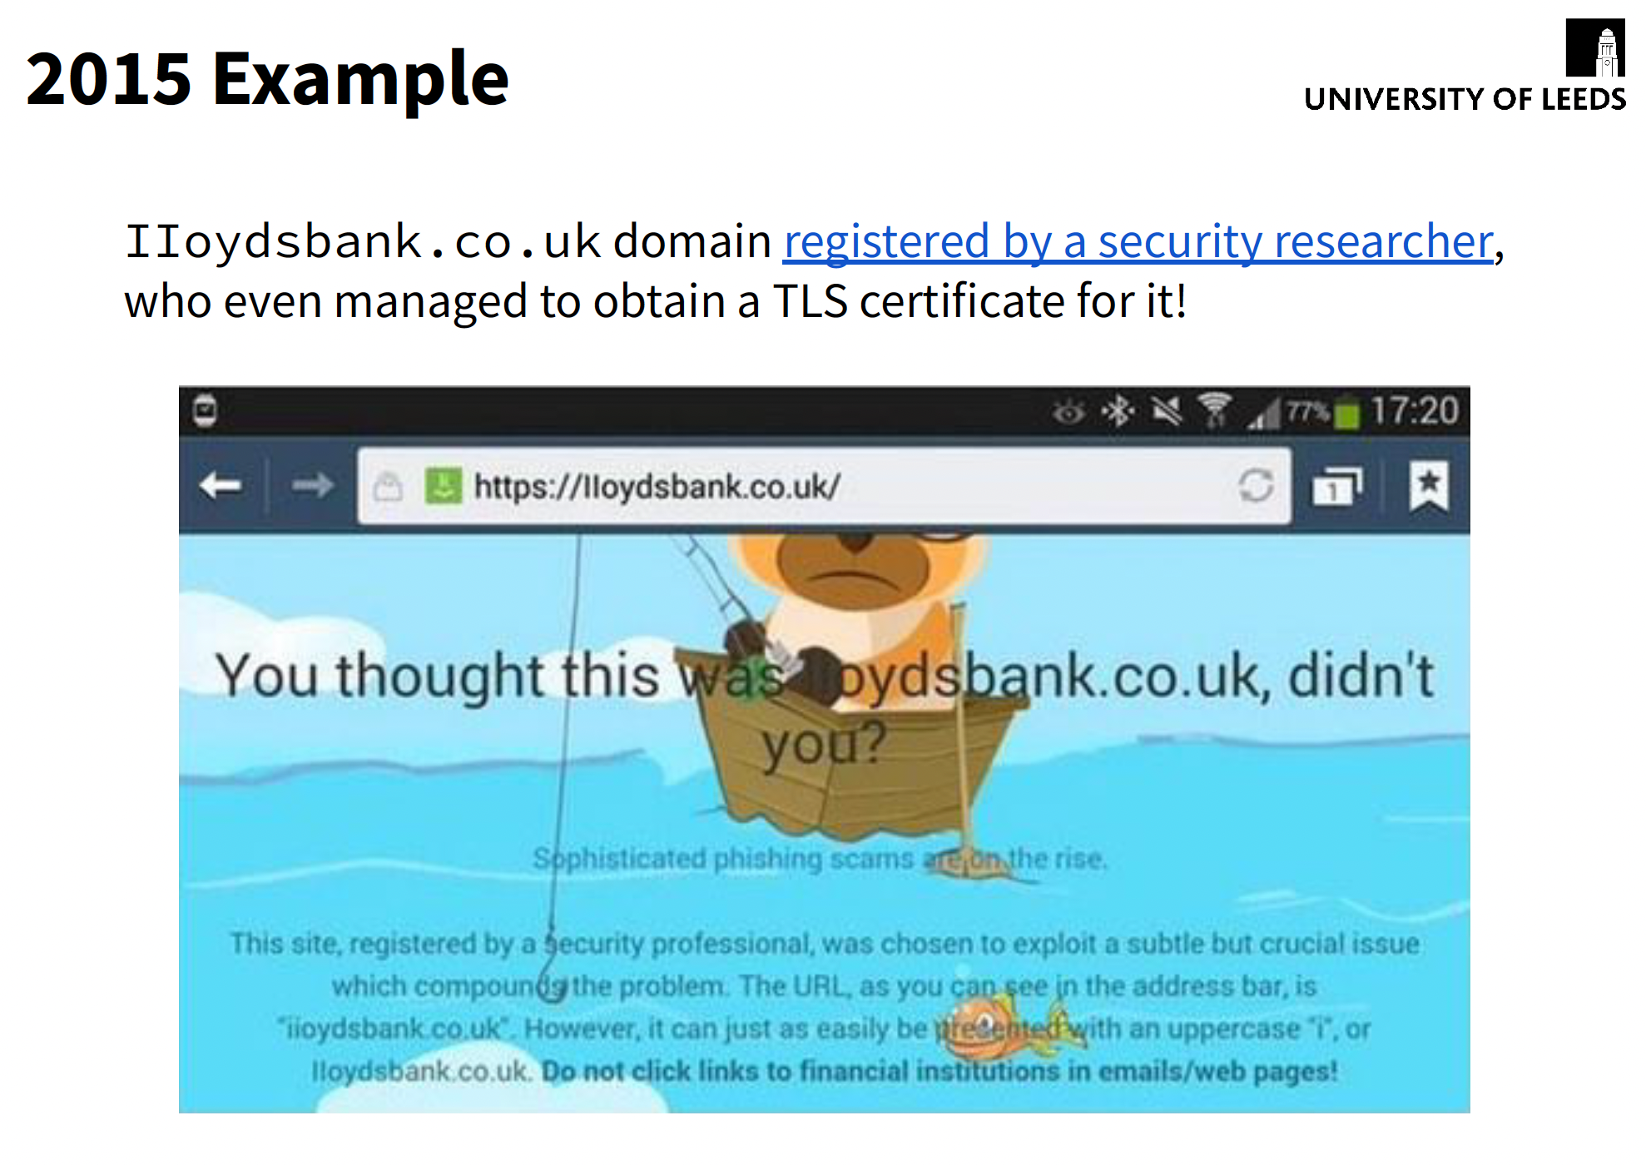

Slide 5
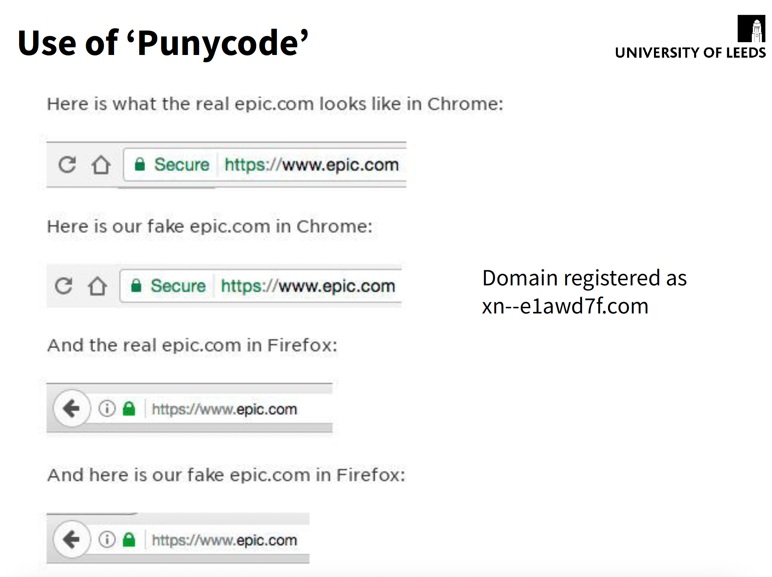

Slide 6
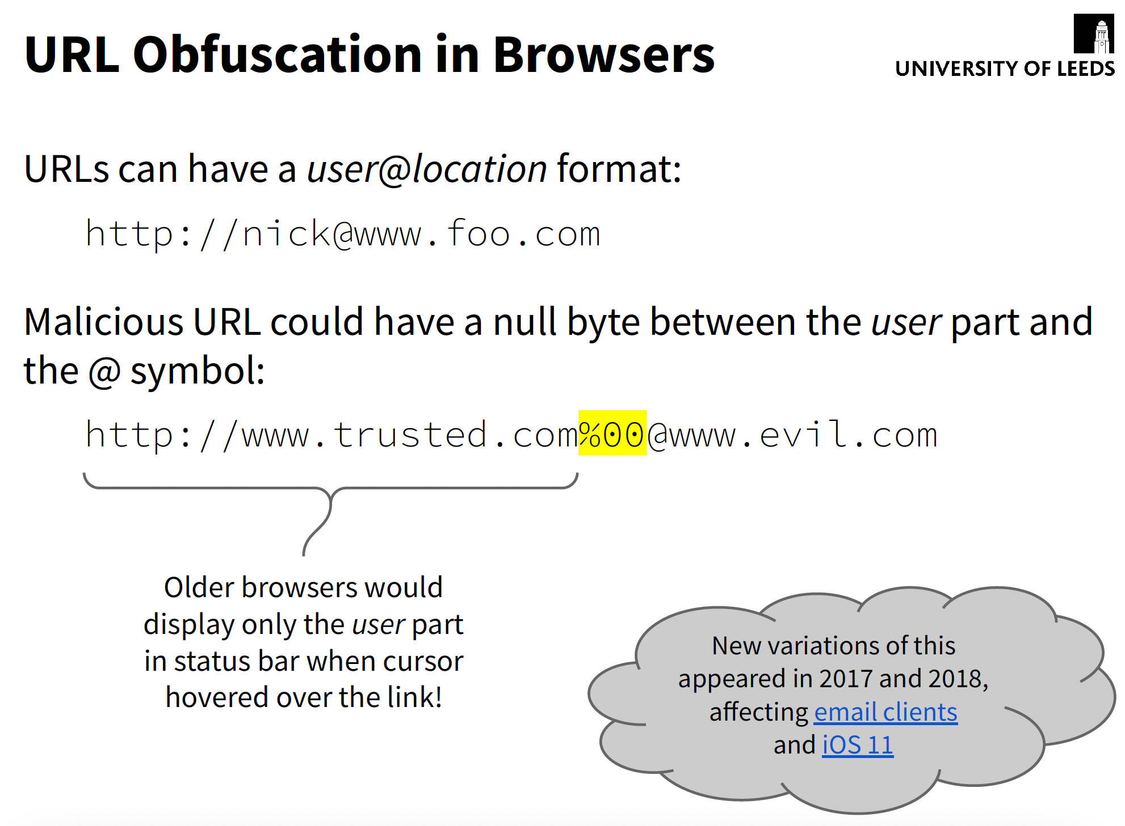

Slide 7
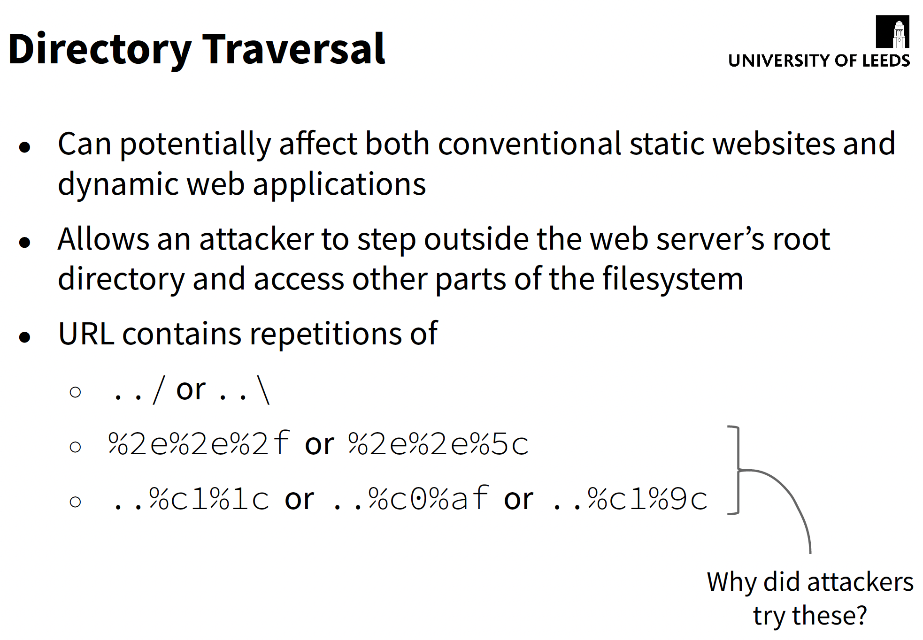

Slide 8
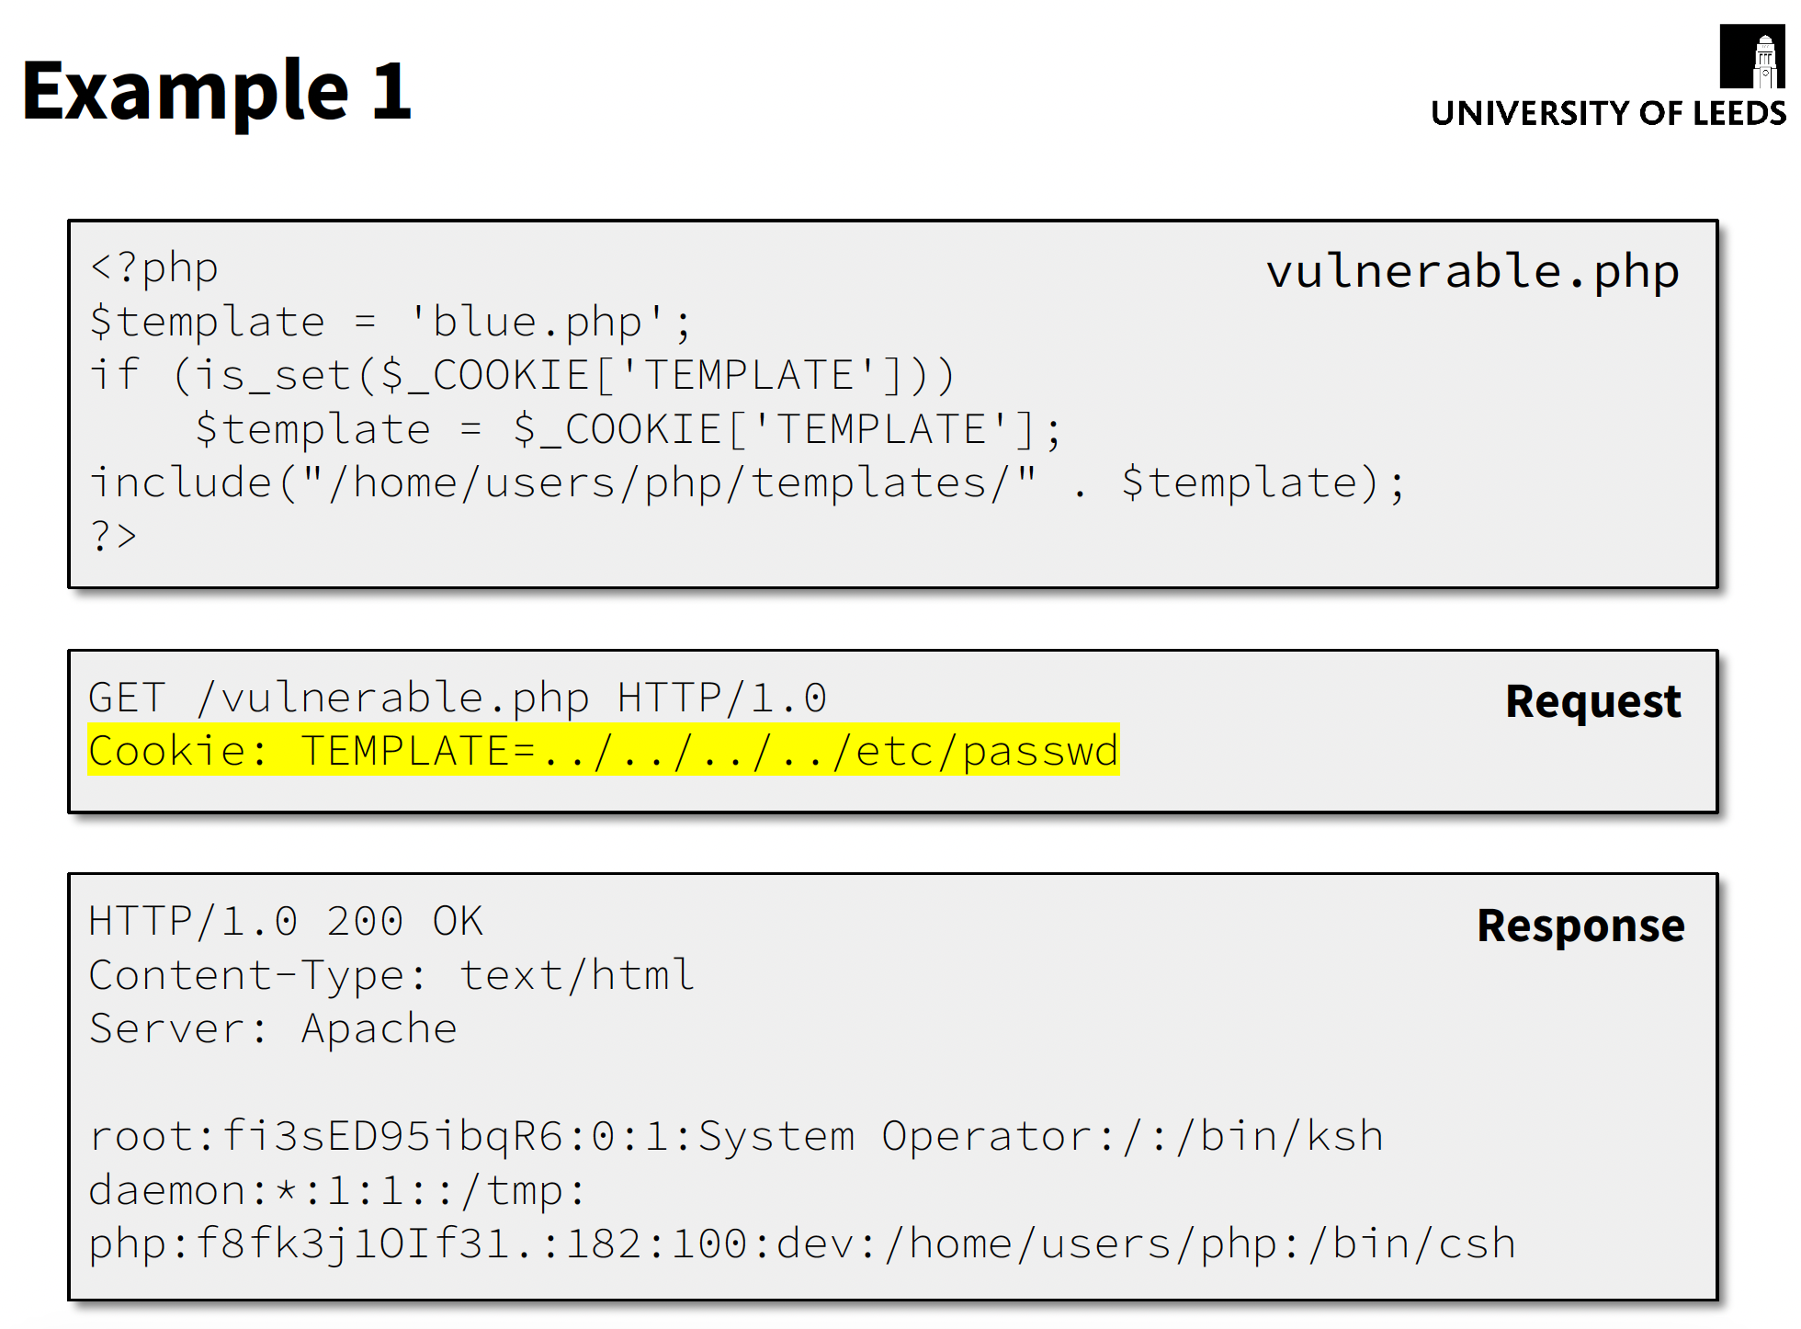

Slide 9
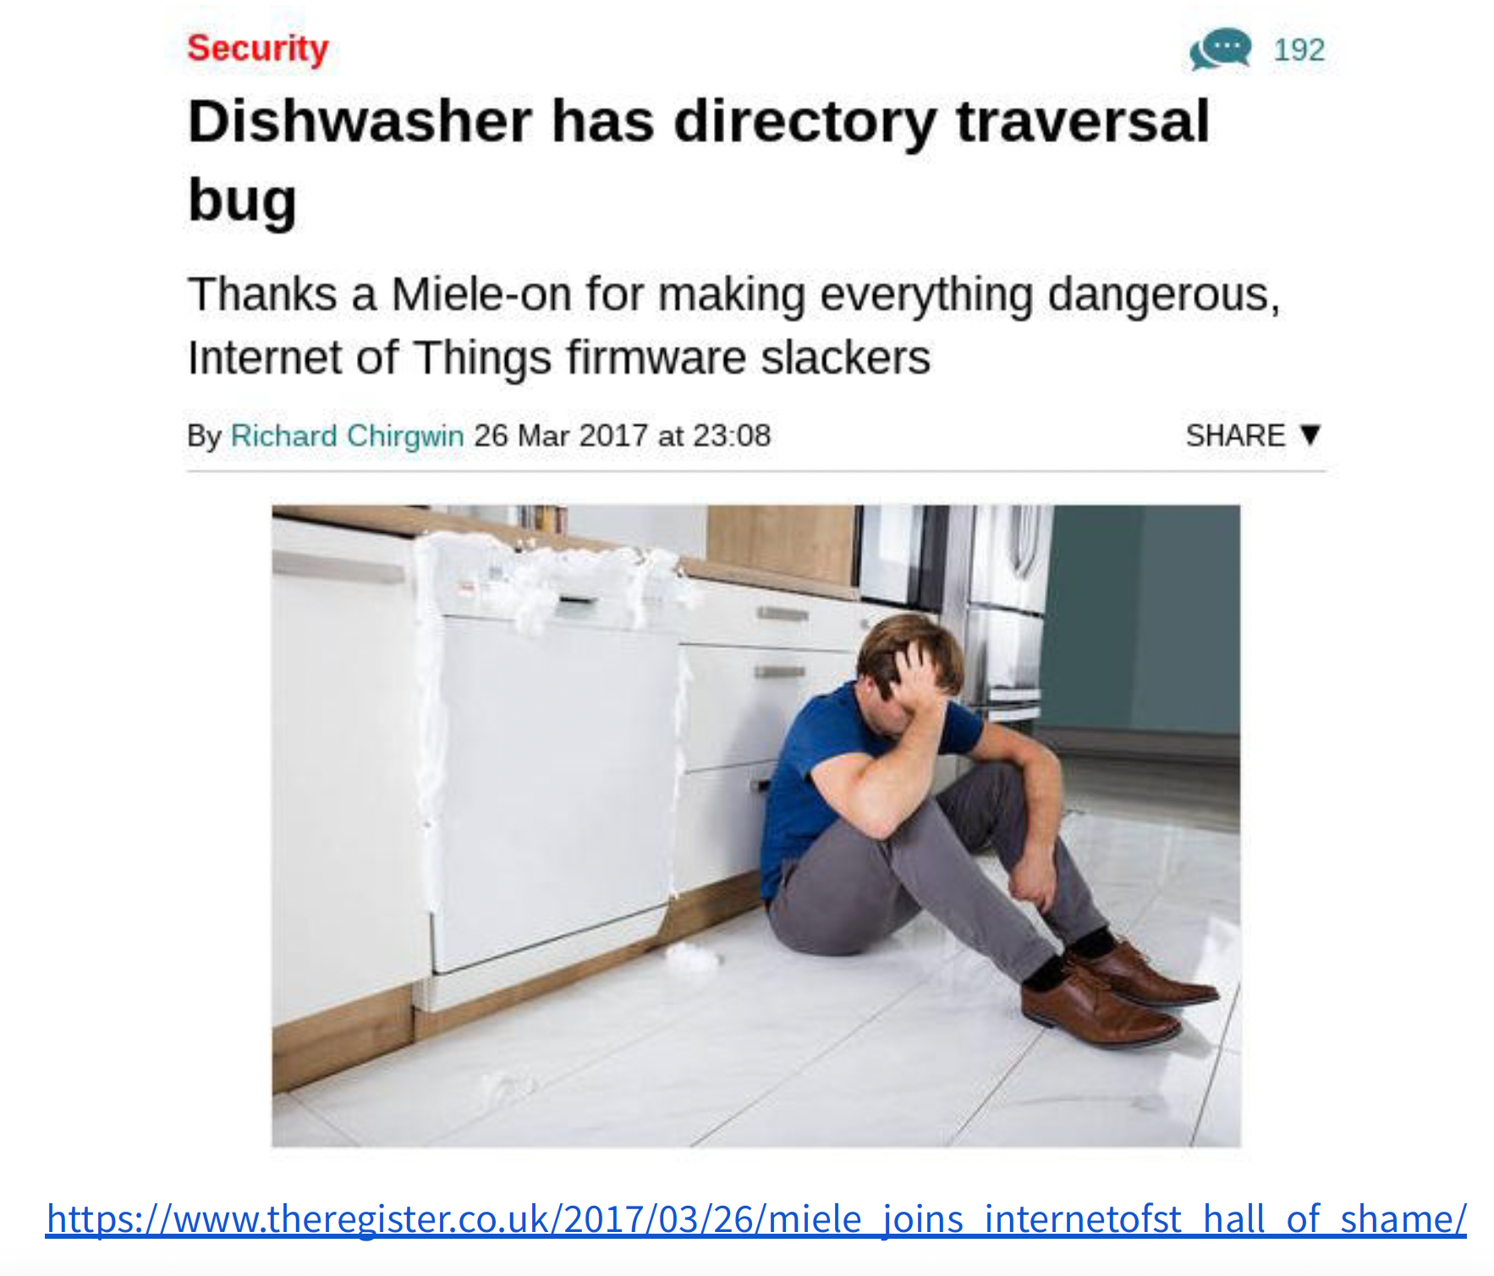

Slide 10
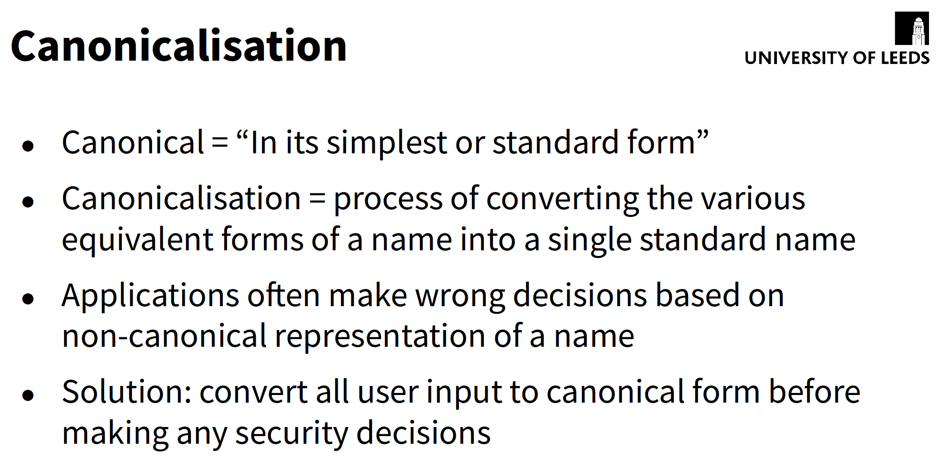

Slide 11
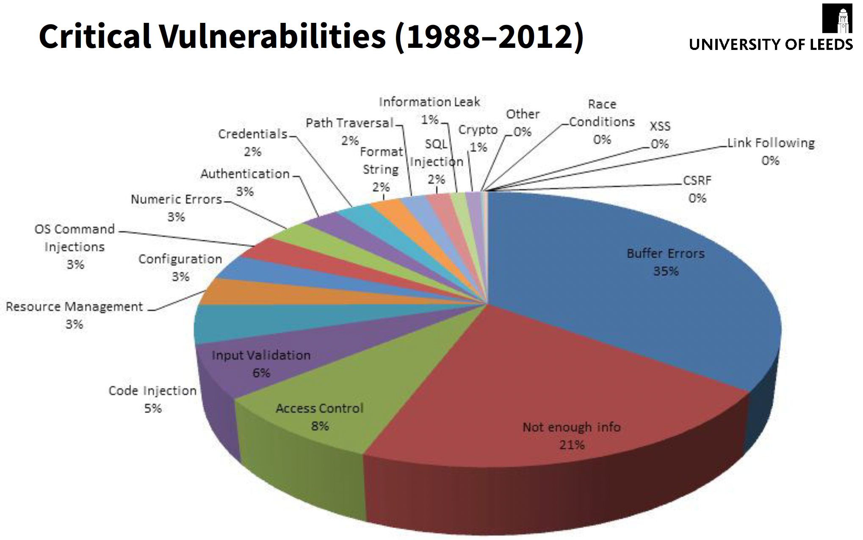

Slide 12
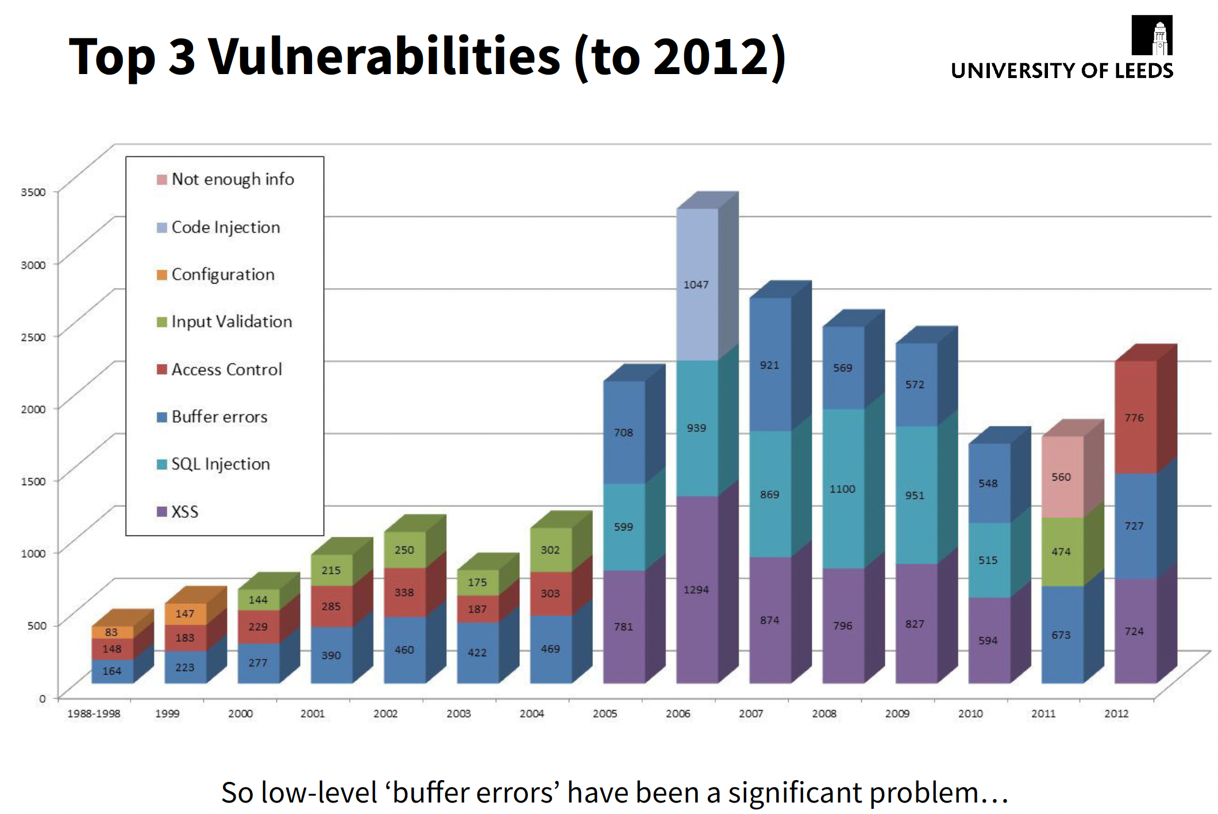

Slide 13
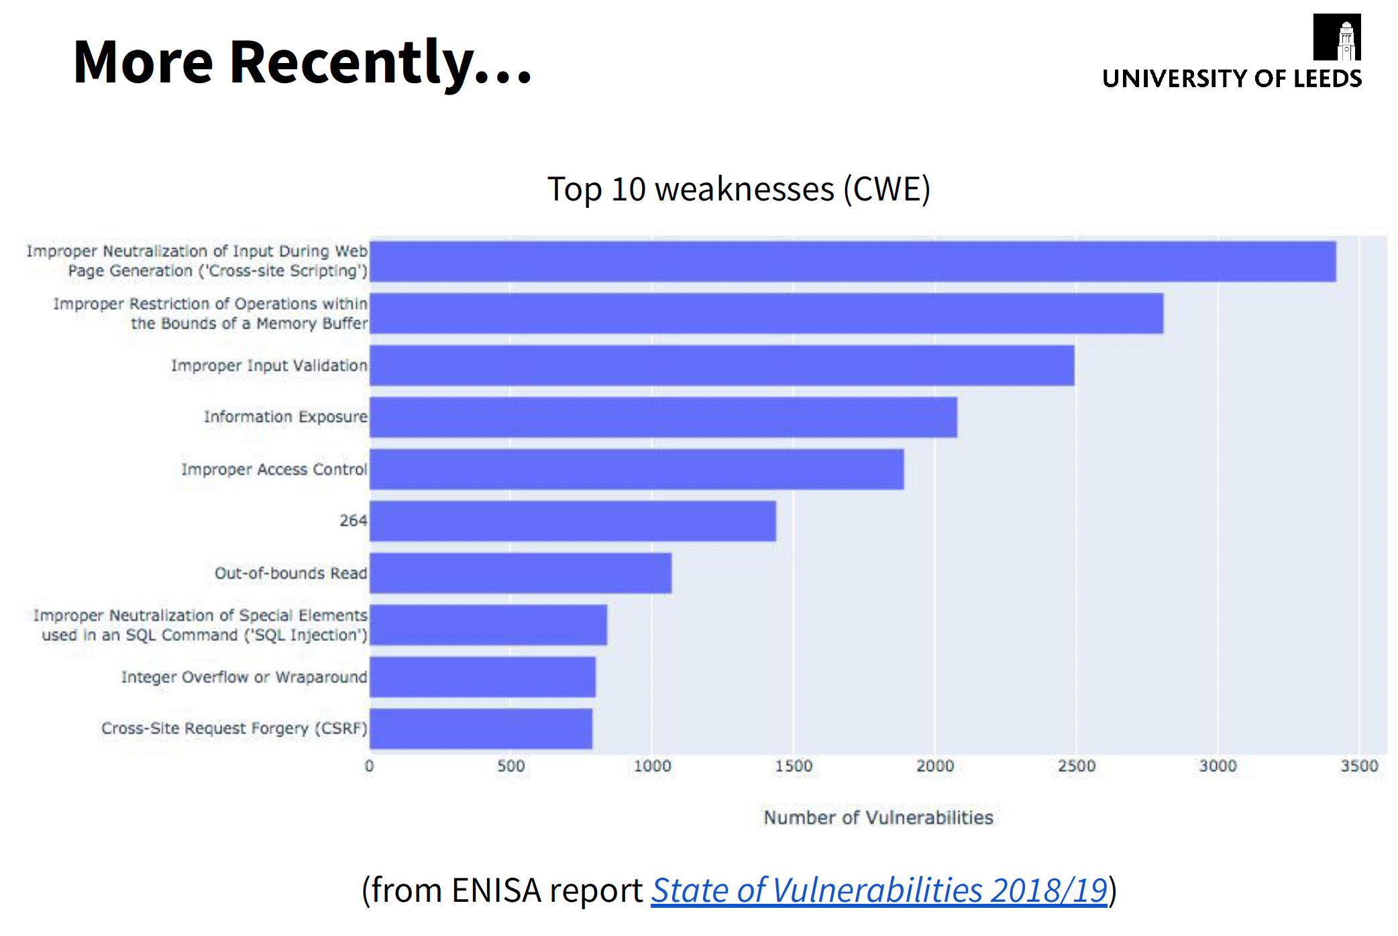

Slide 14
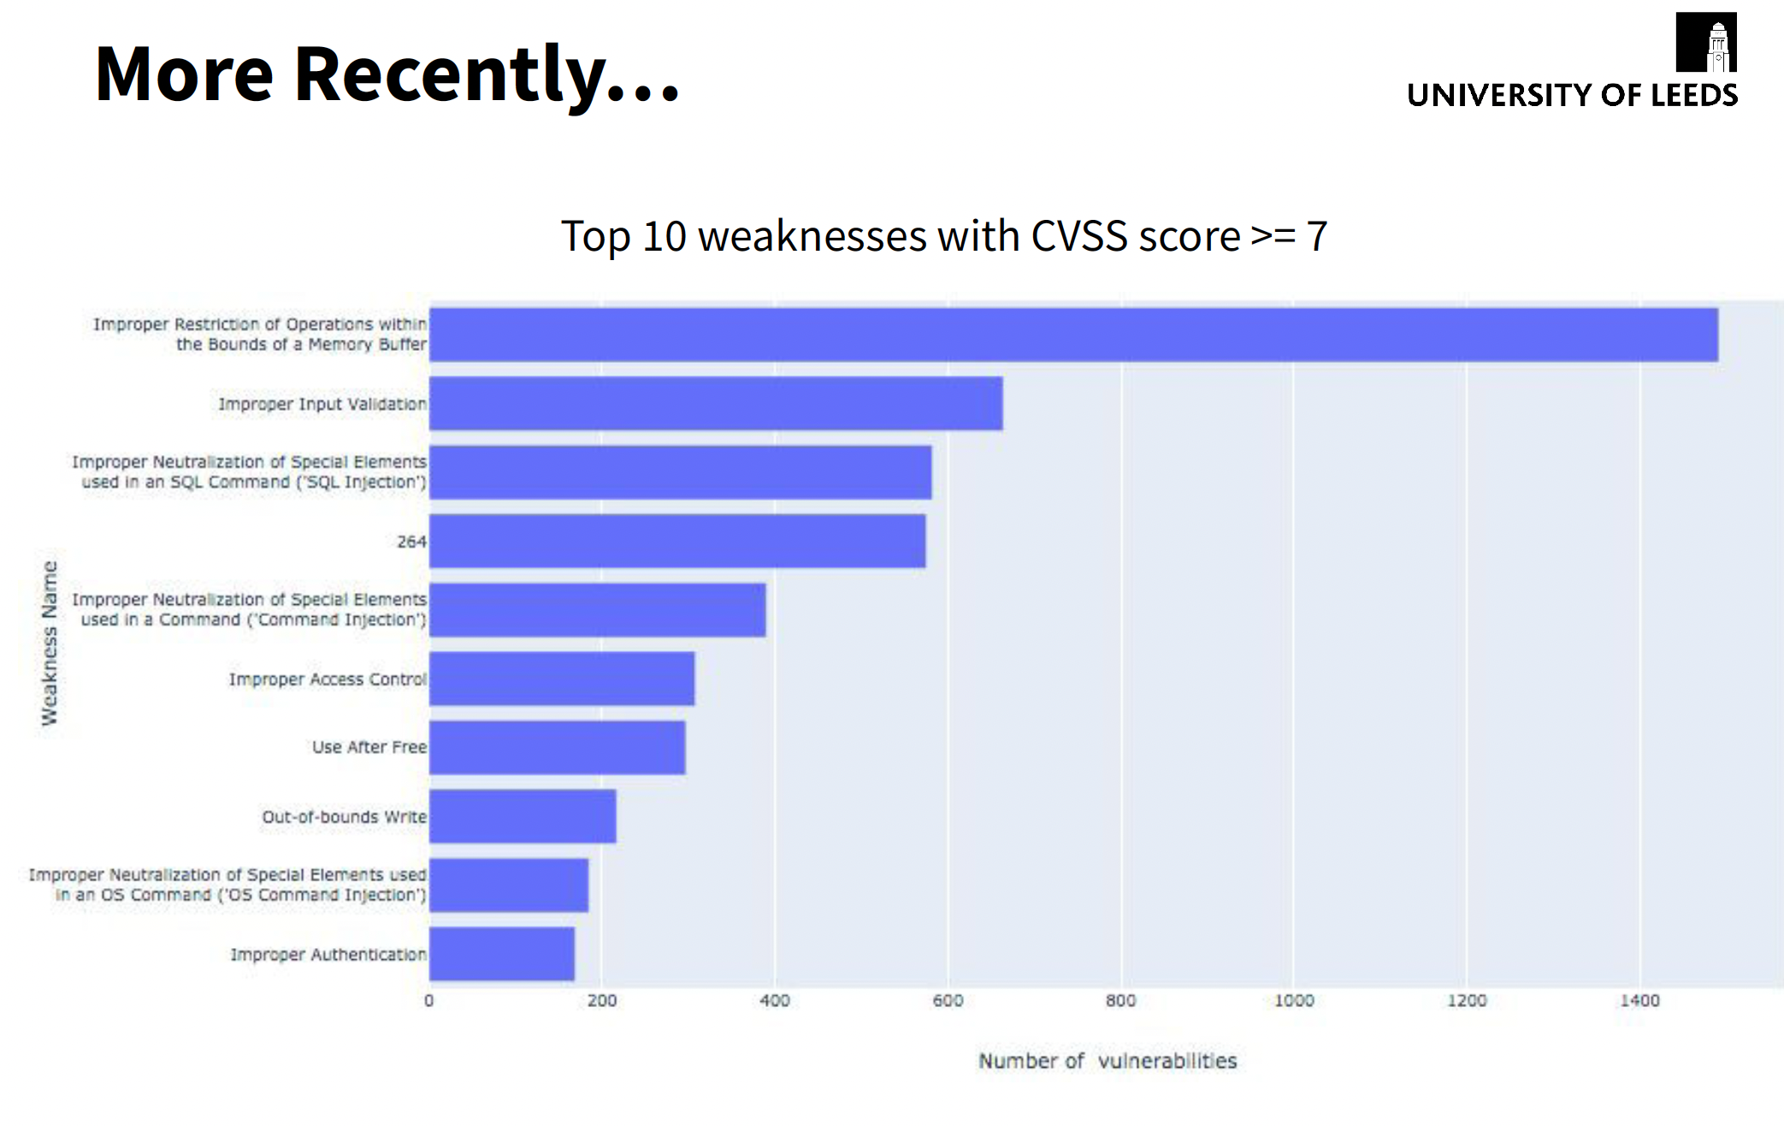

Slide 15
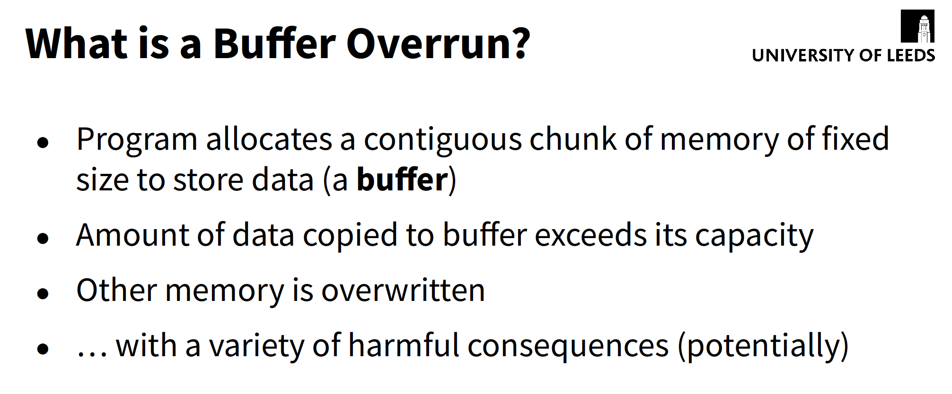

Slide 16
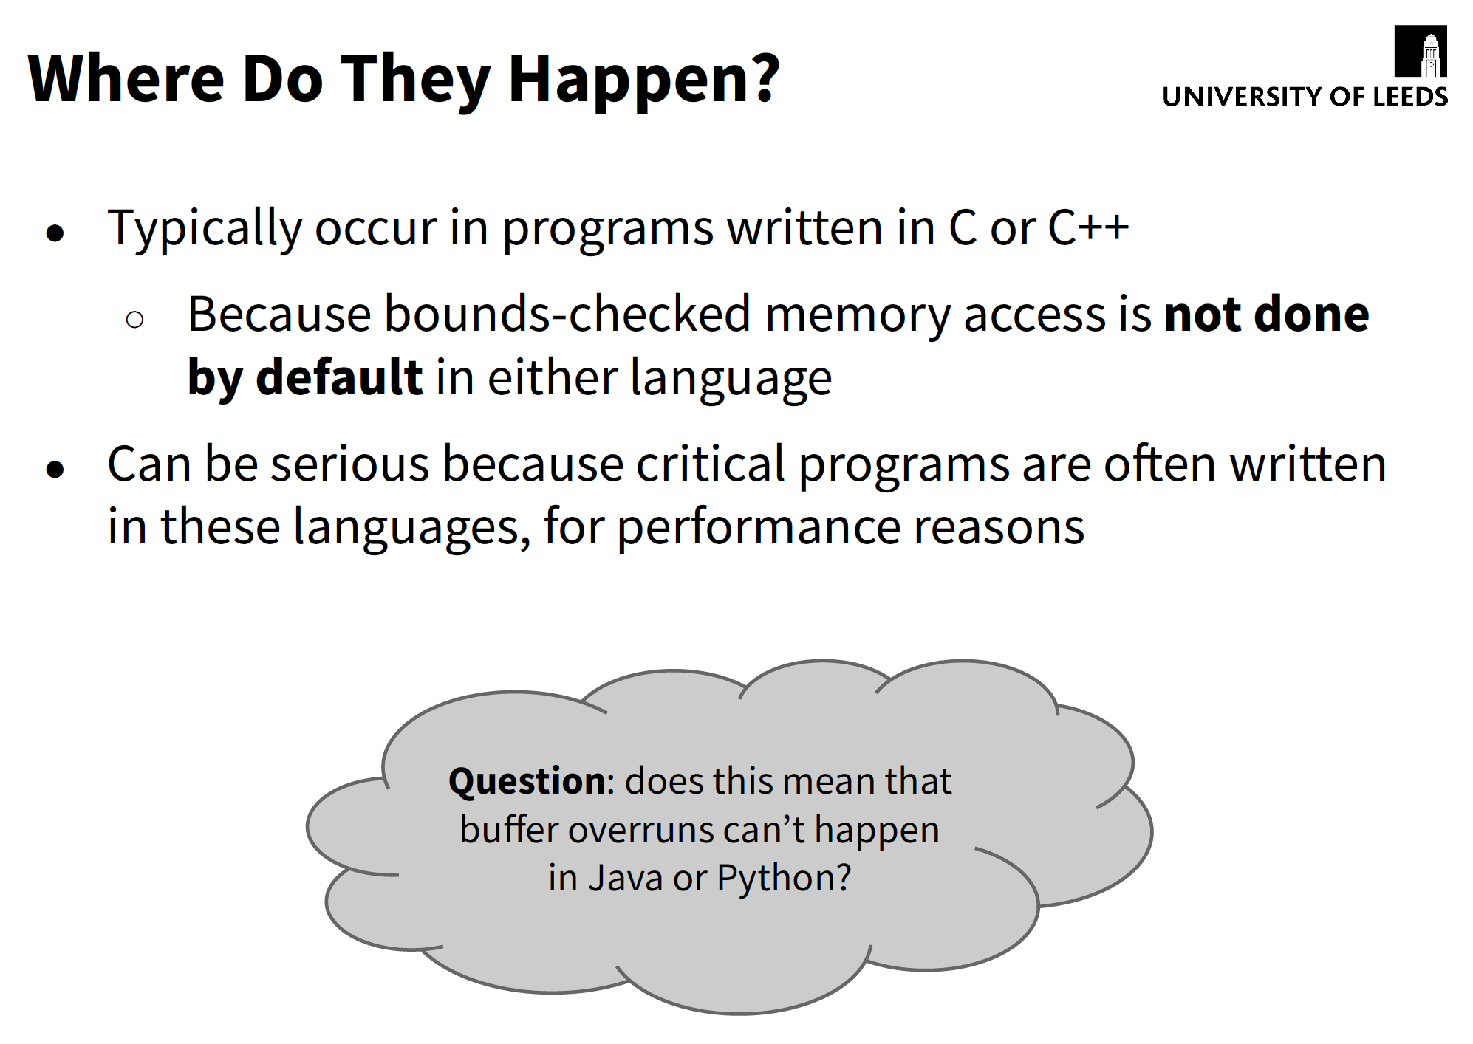

Slide 17
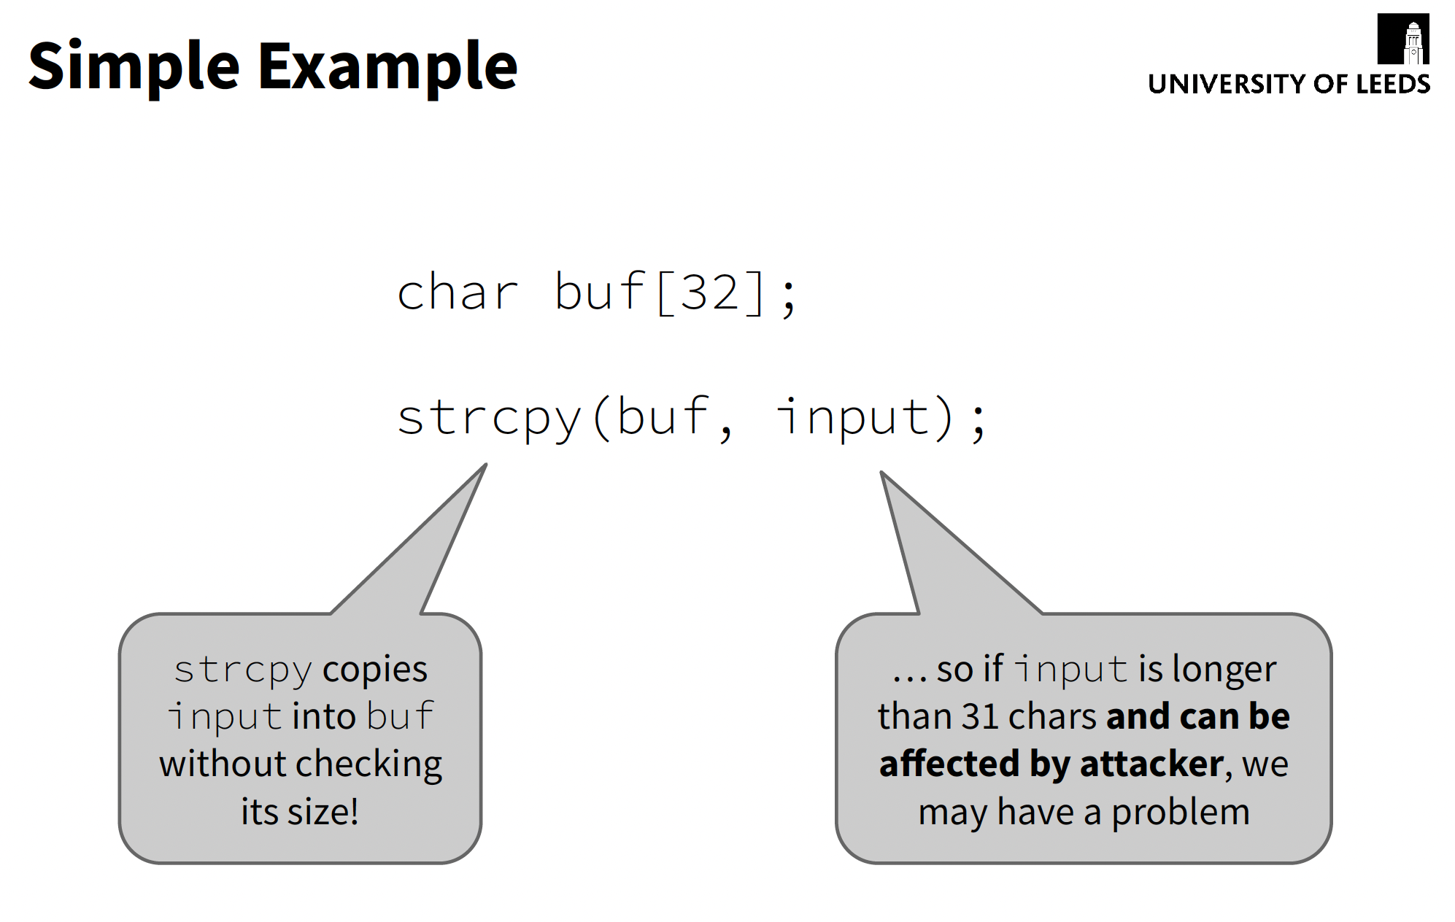

Slide 18
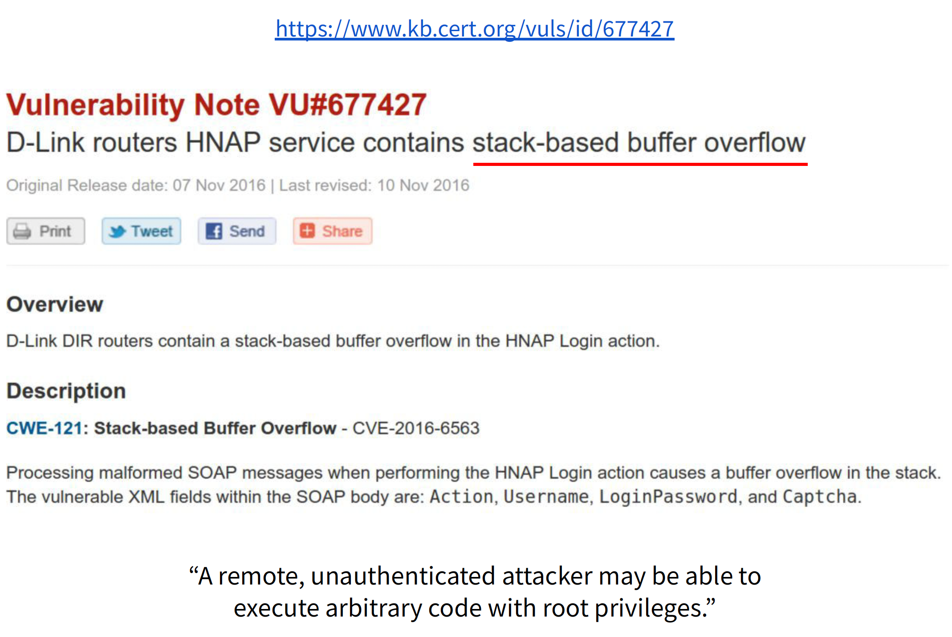

Slide 19
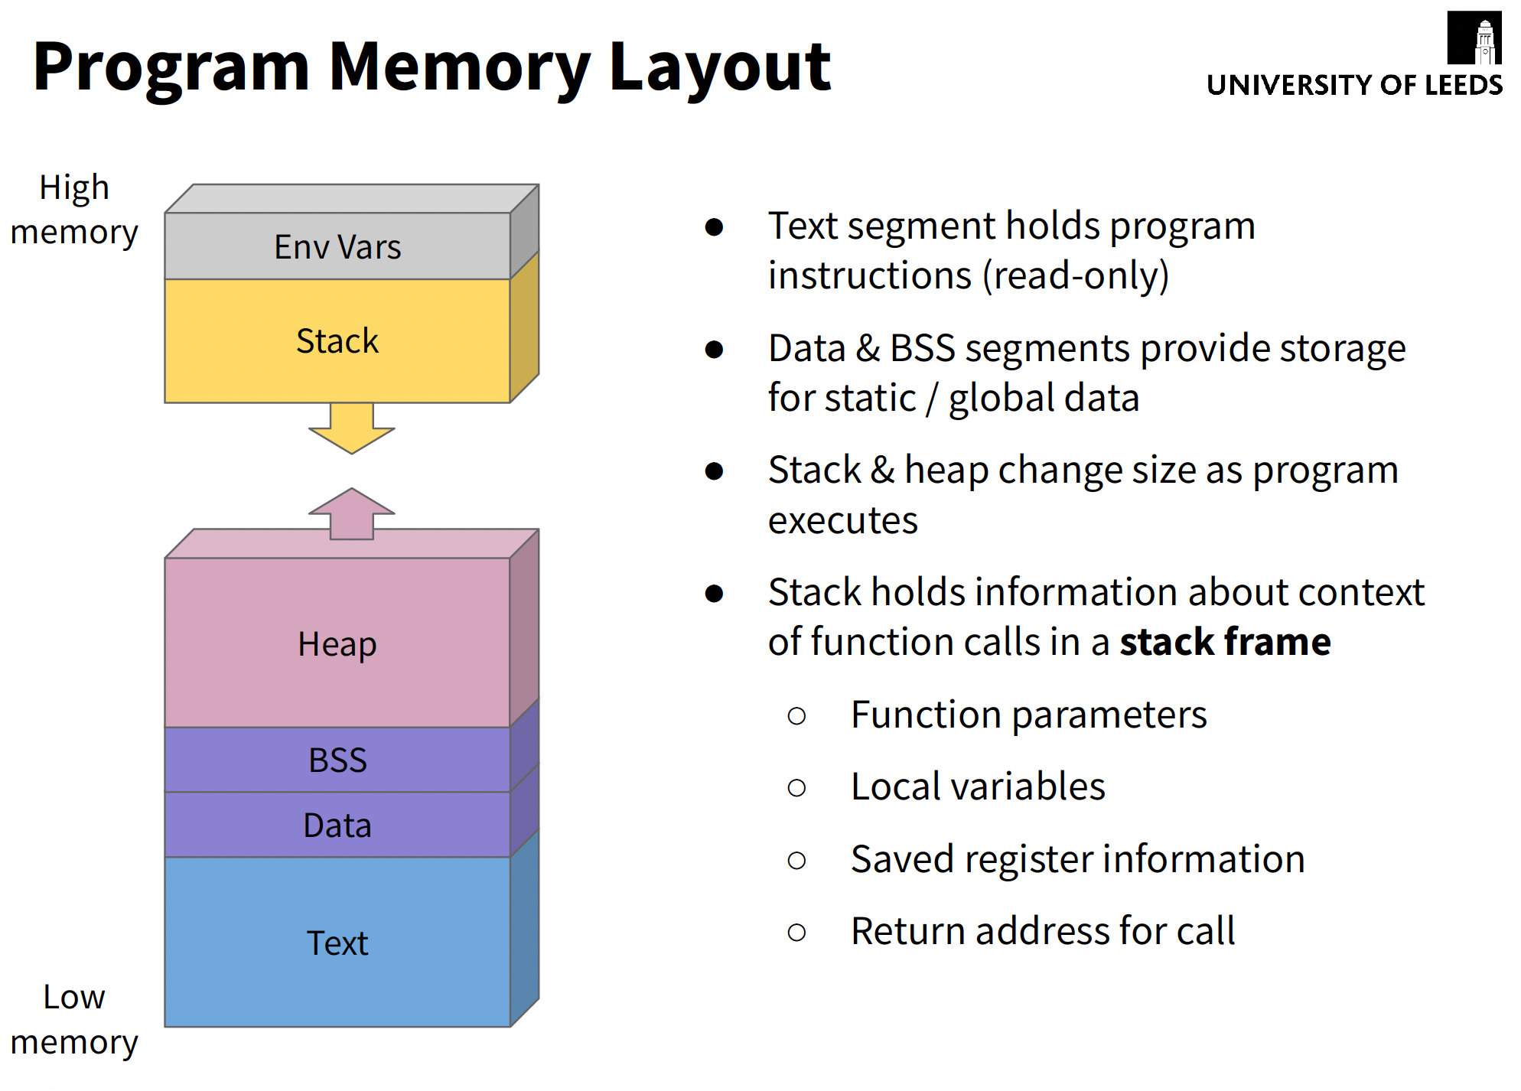

Slide 20
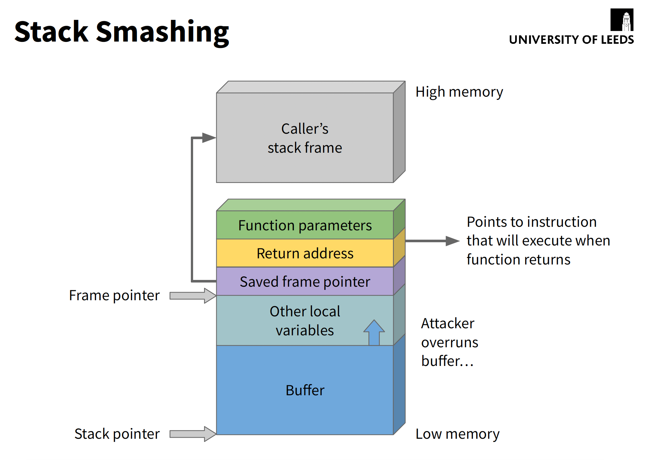

Slide 21
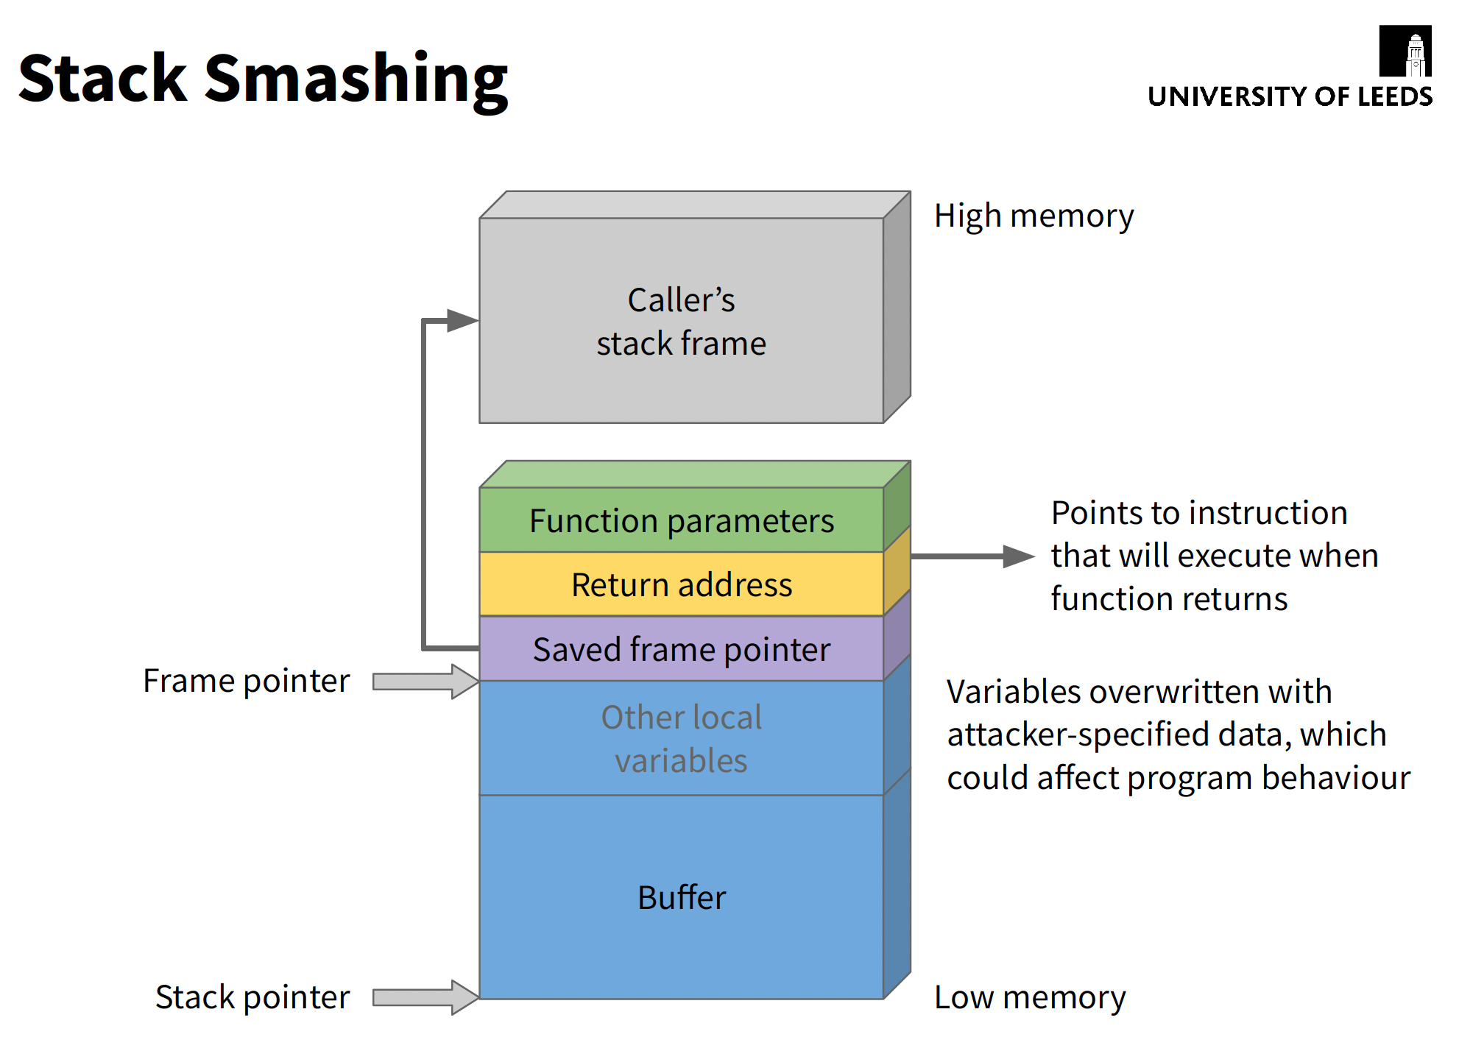

Slide 22
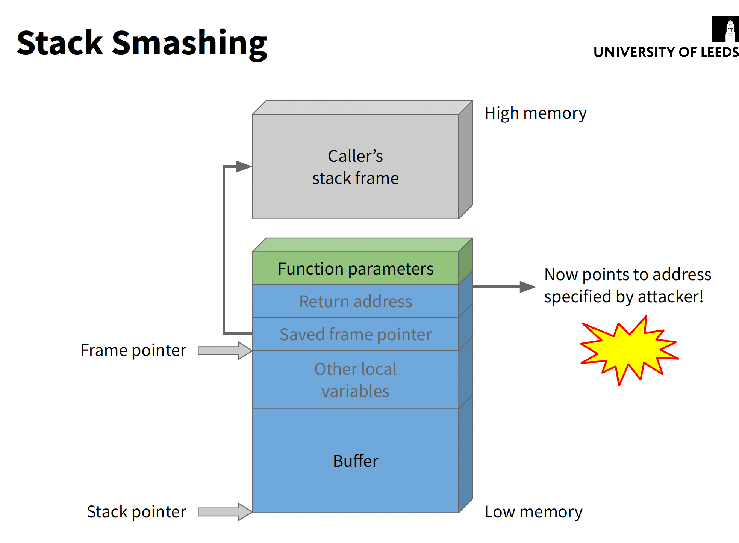

Slide 23
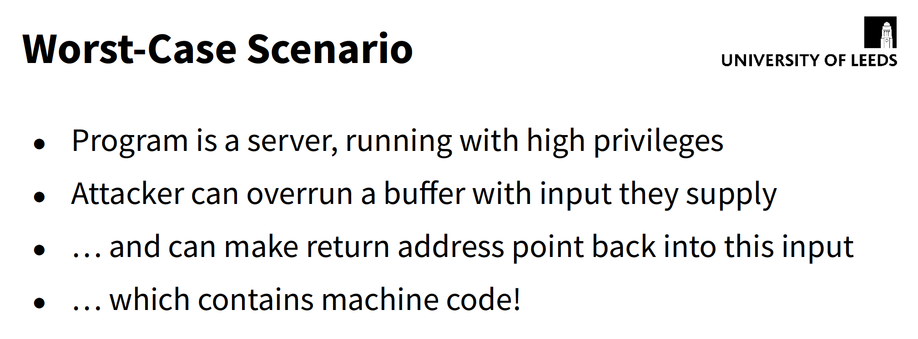

Slide 24
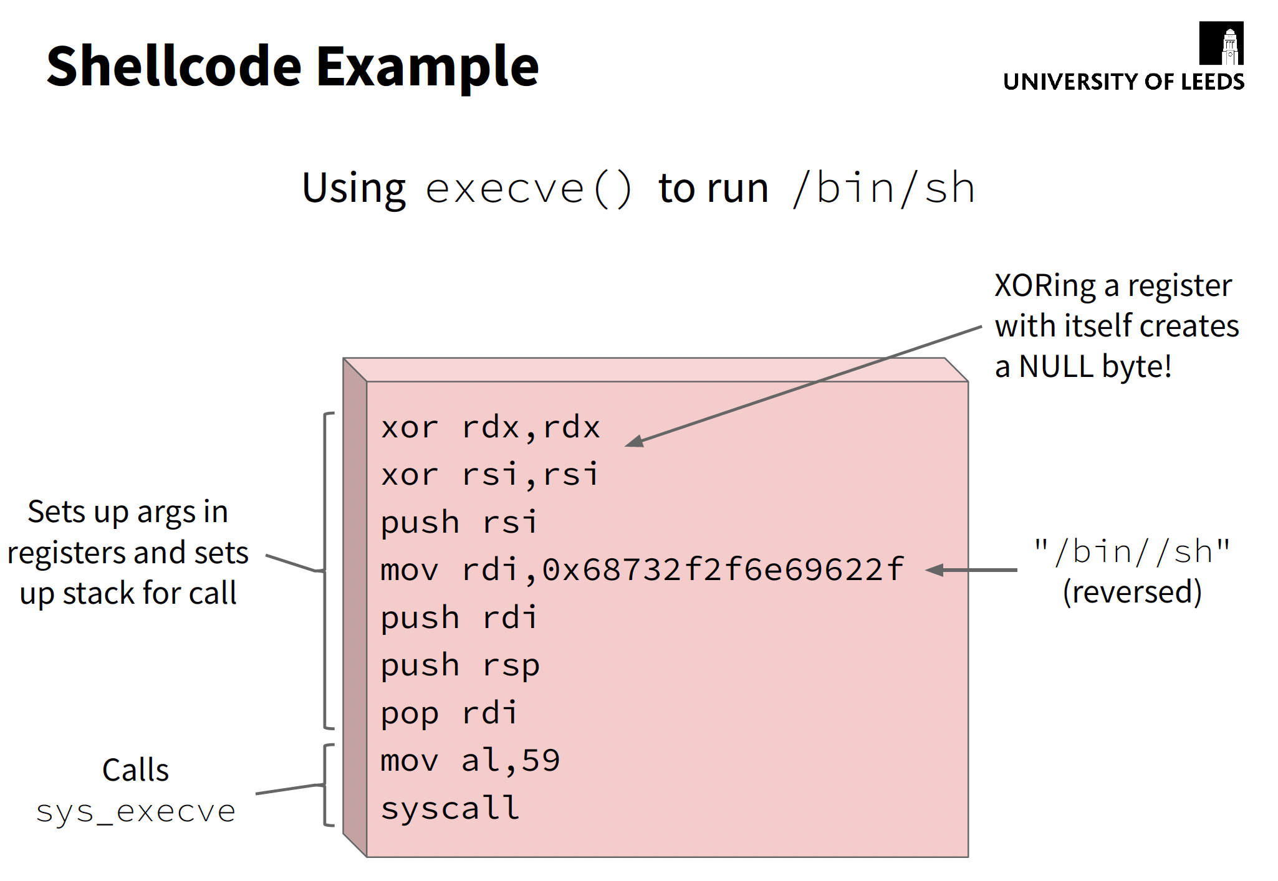

Slide 25
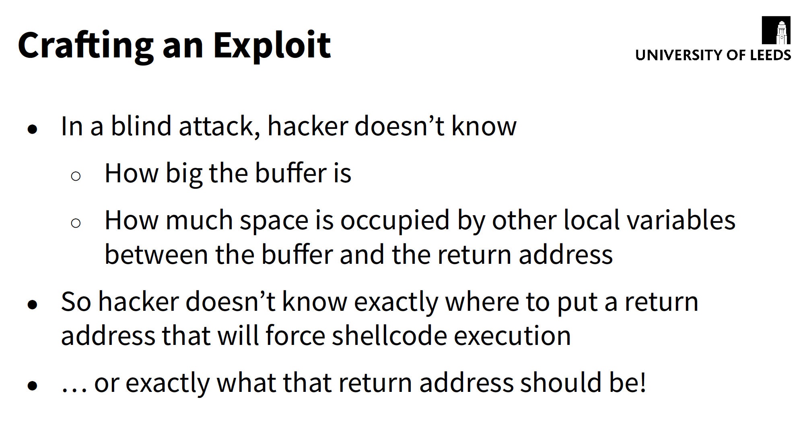

Slide 26
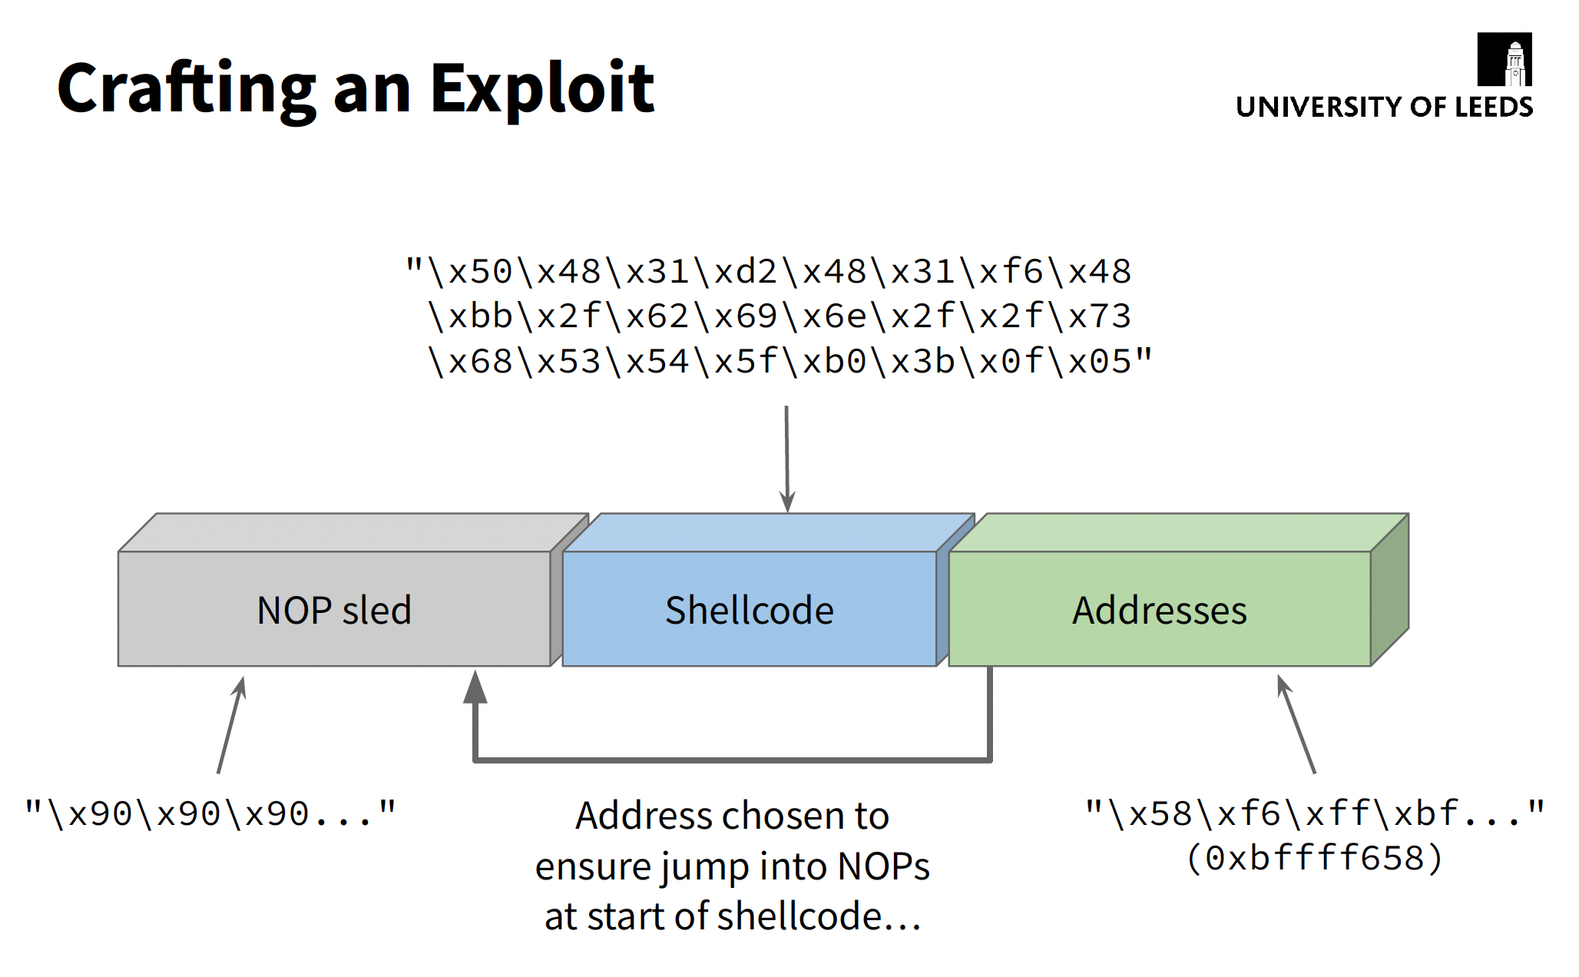

Slide 27
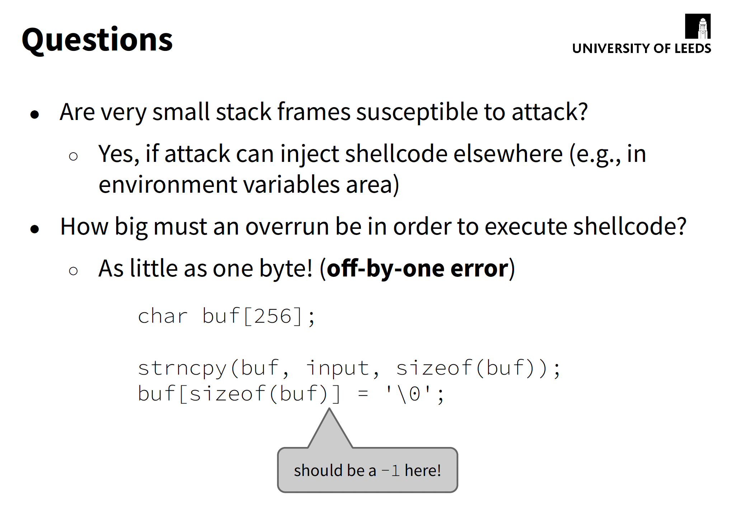

Slide 28
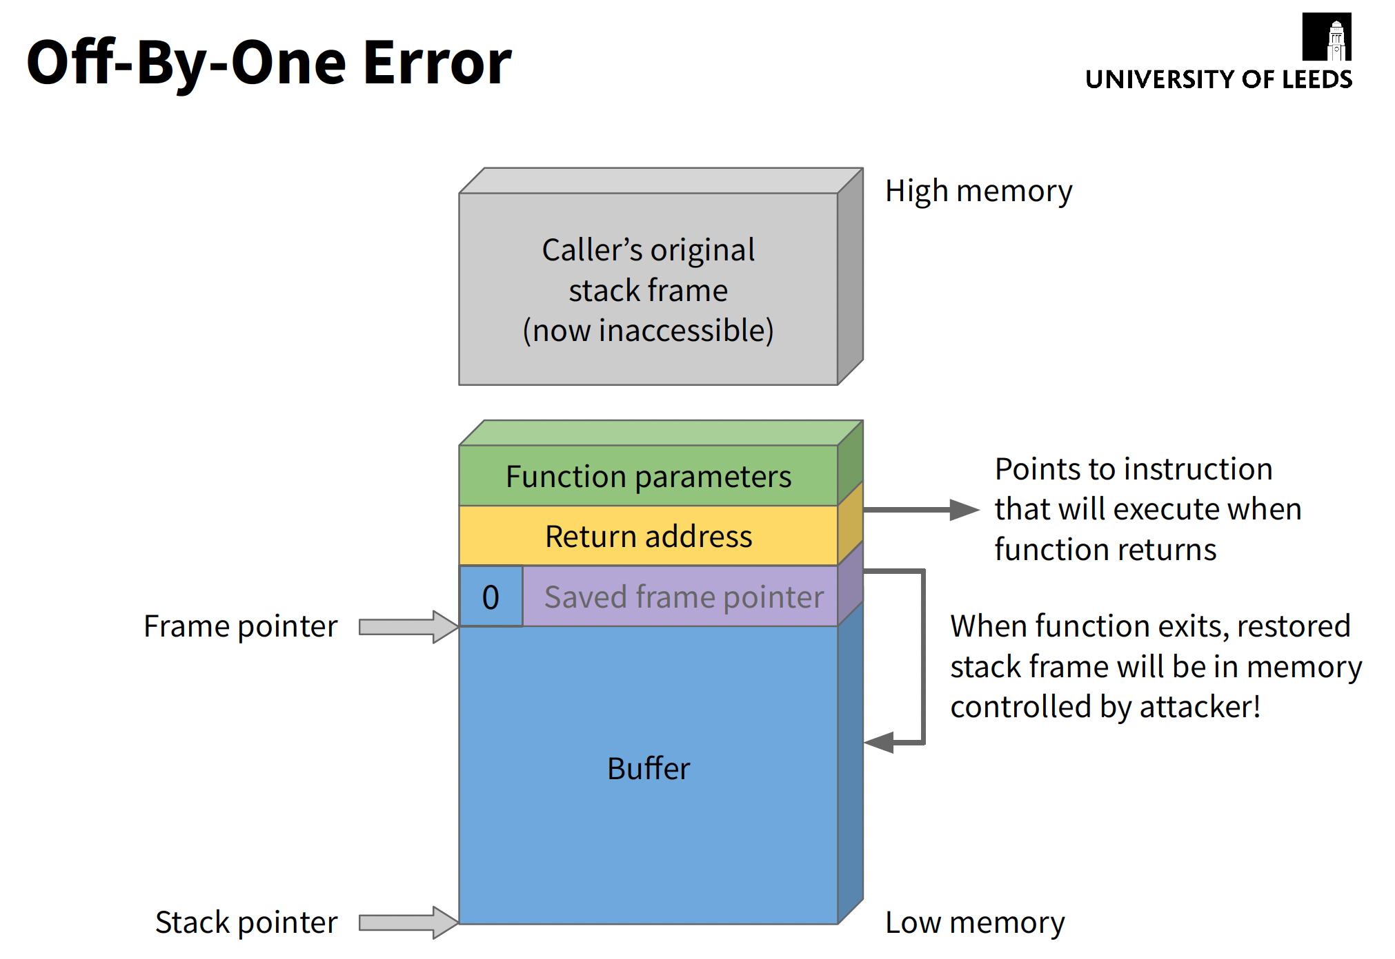

Slide 29
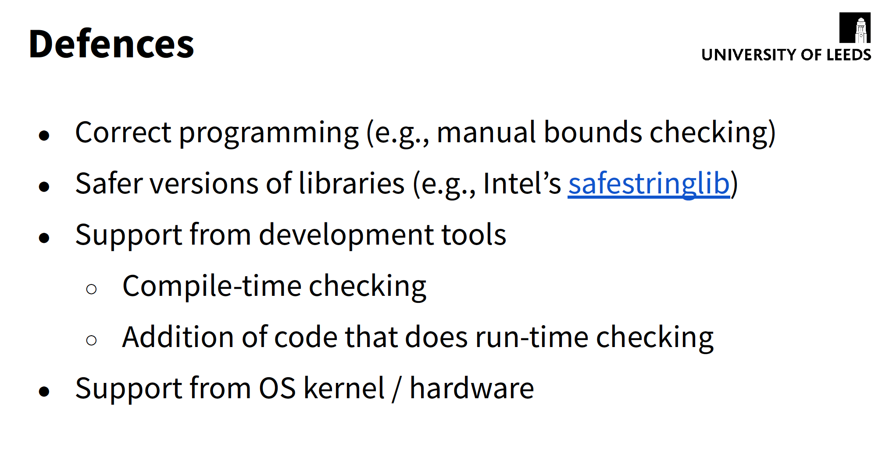

Slide 30
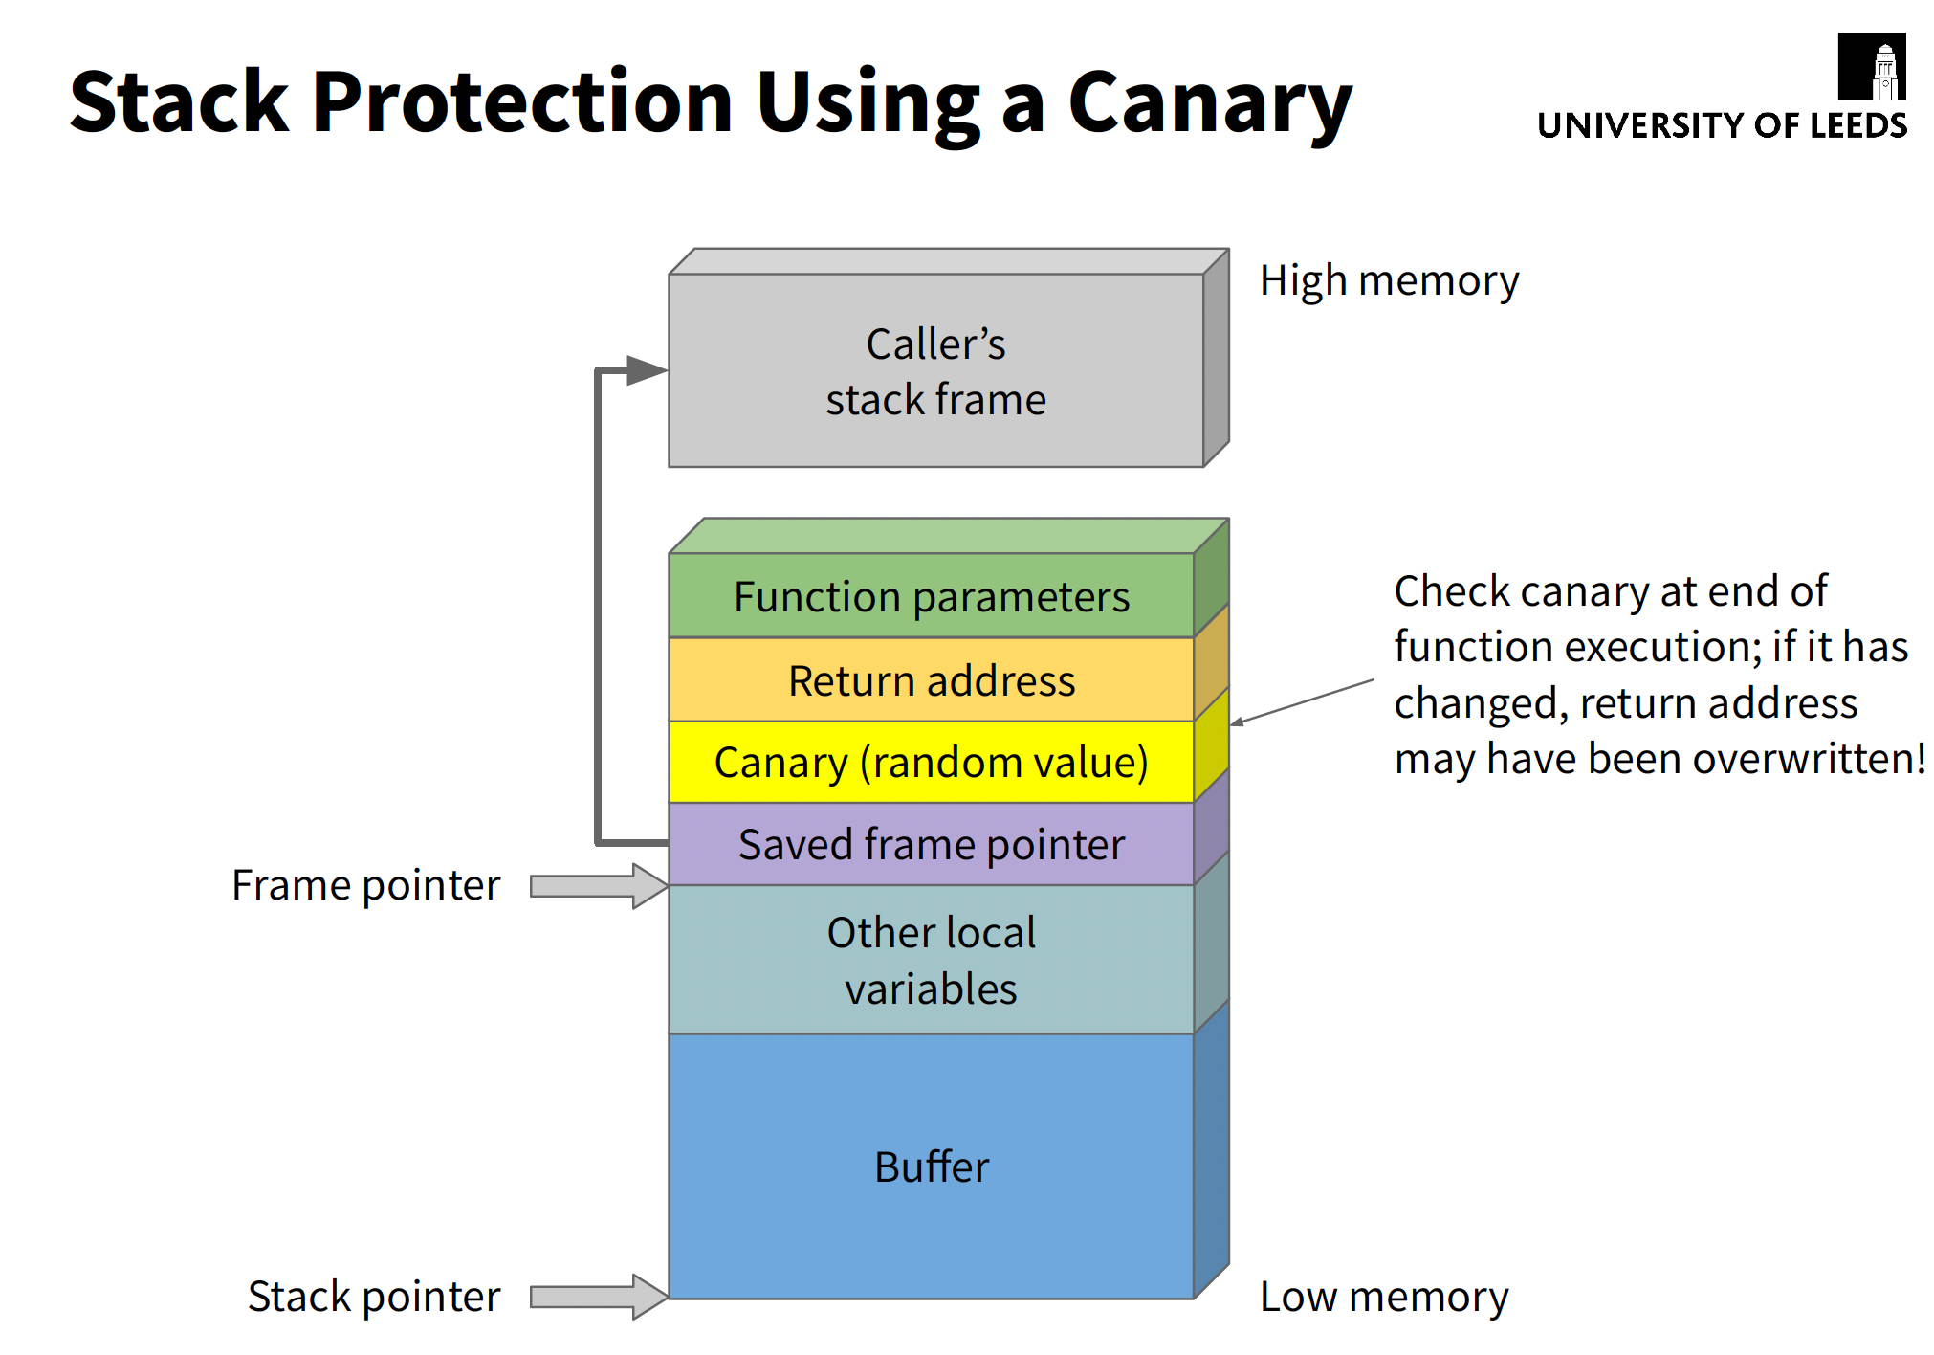

Slide 31
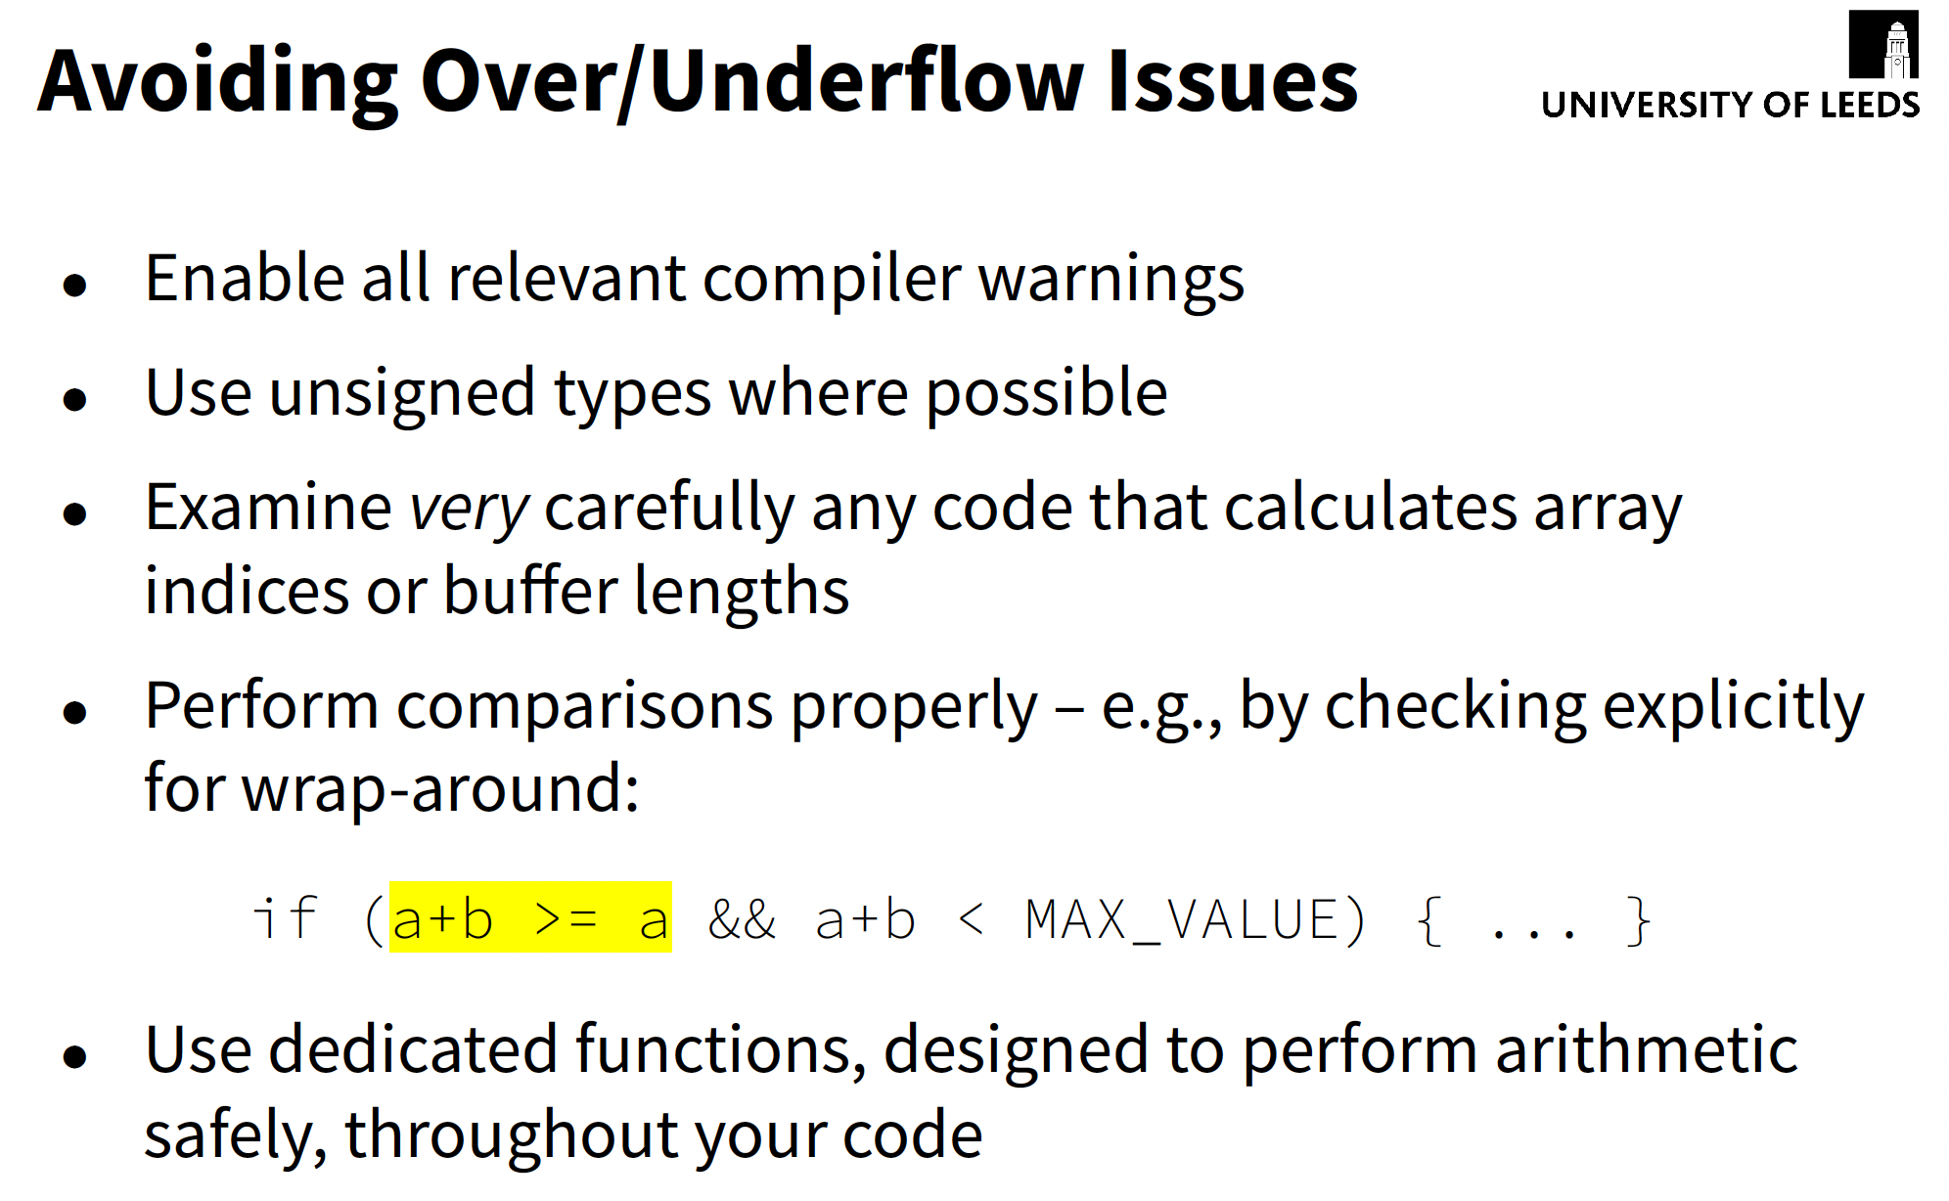

Slide 32
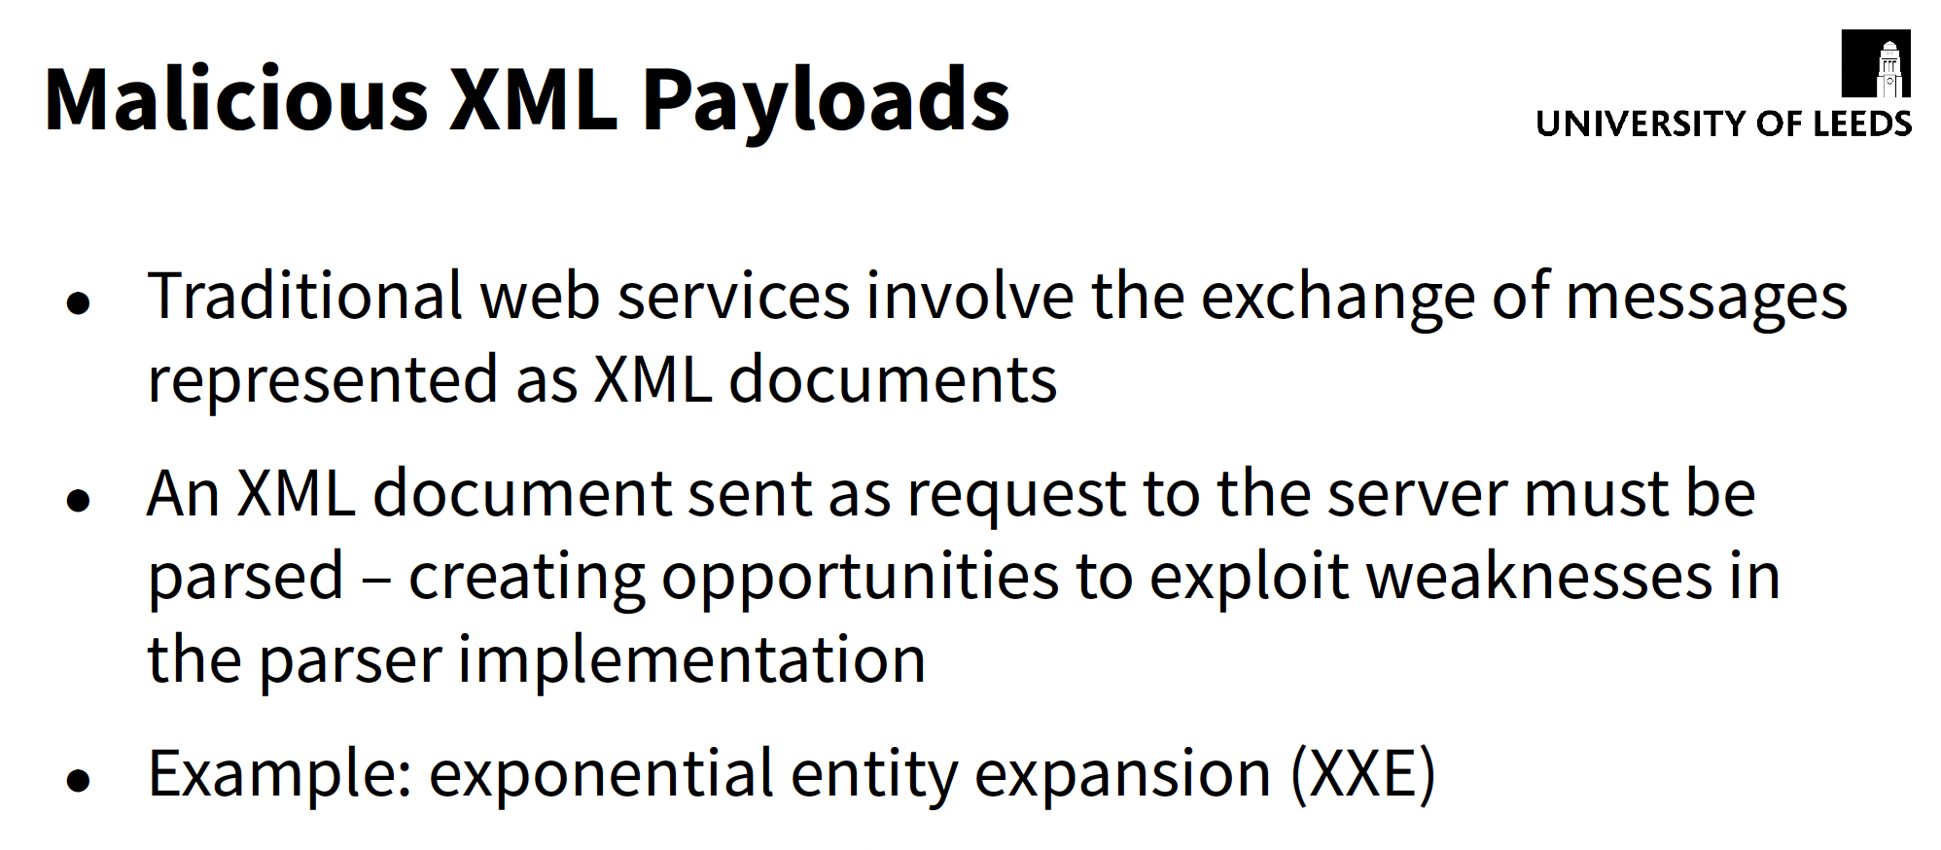

Slide 33
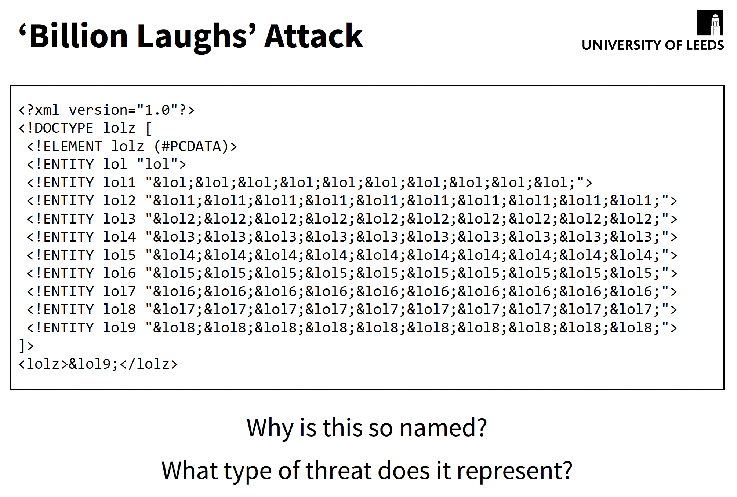

Slide 34
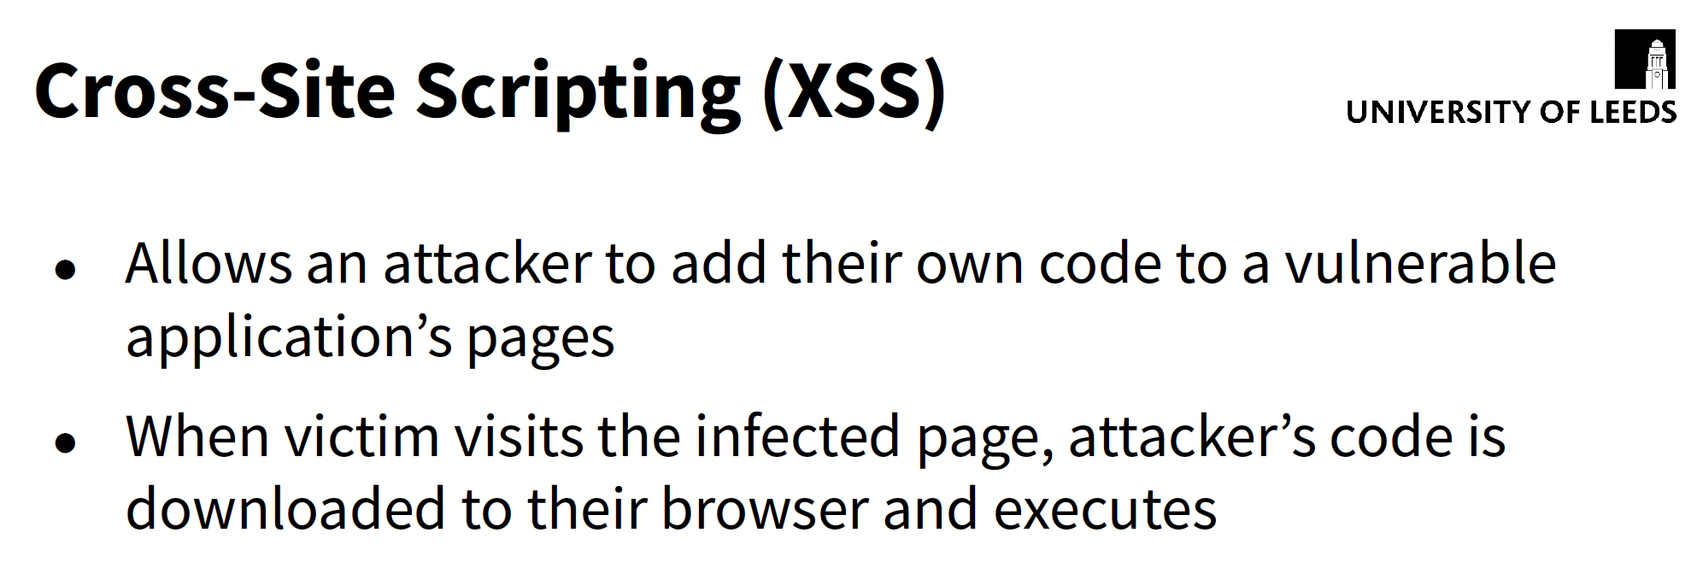

Slide 35
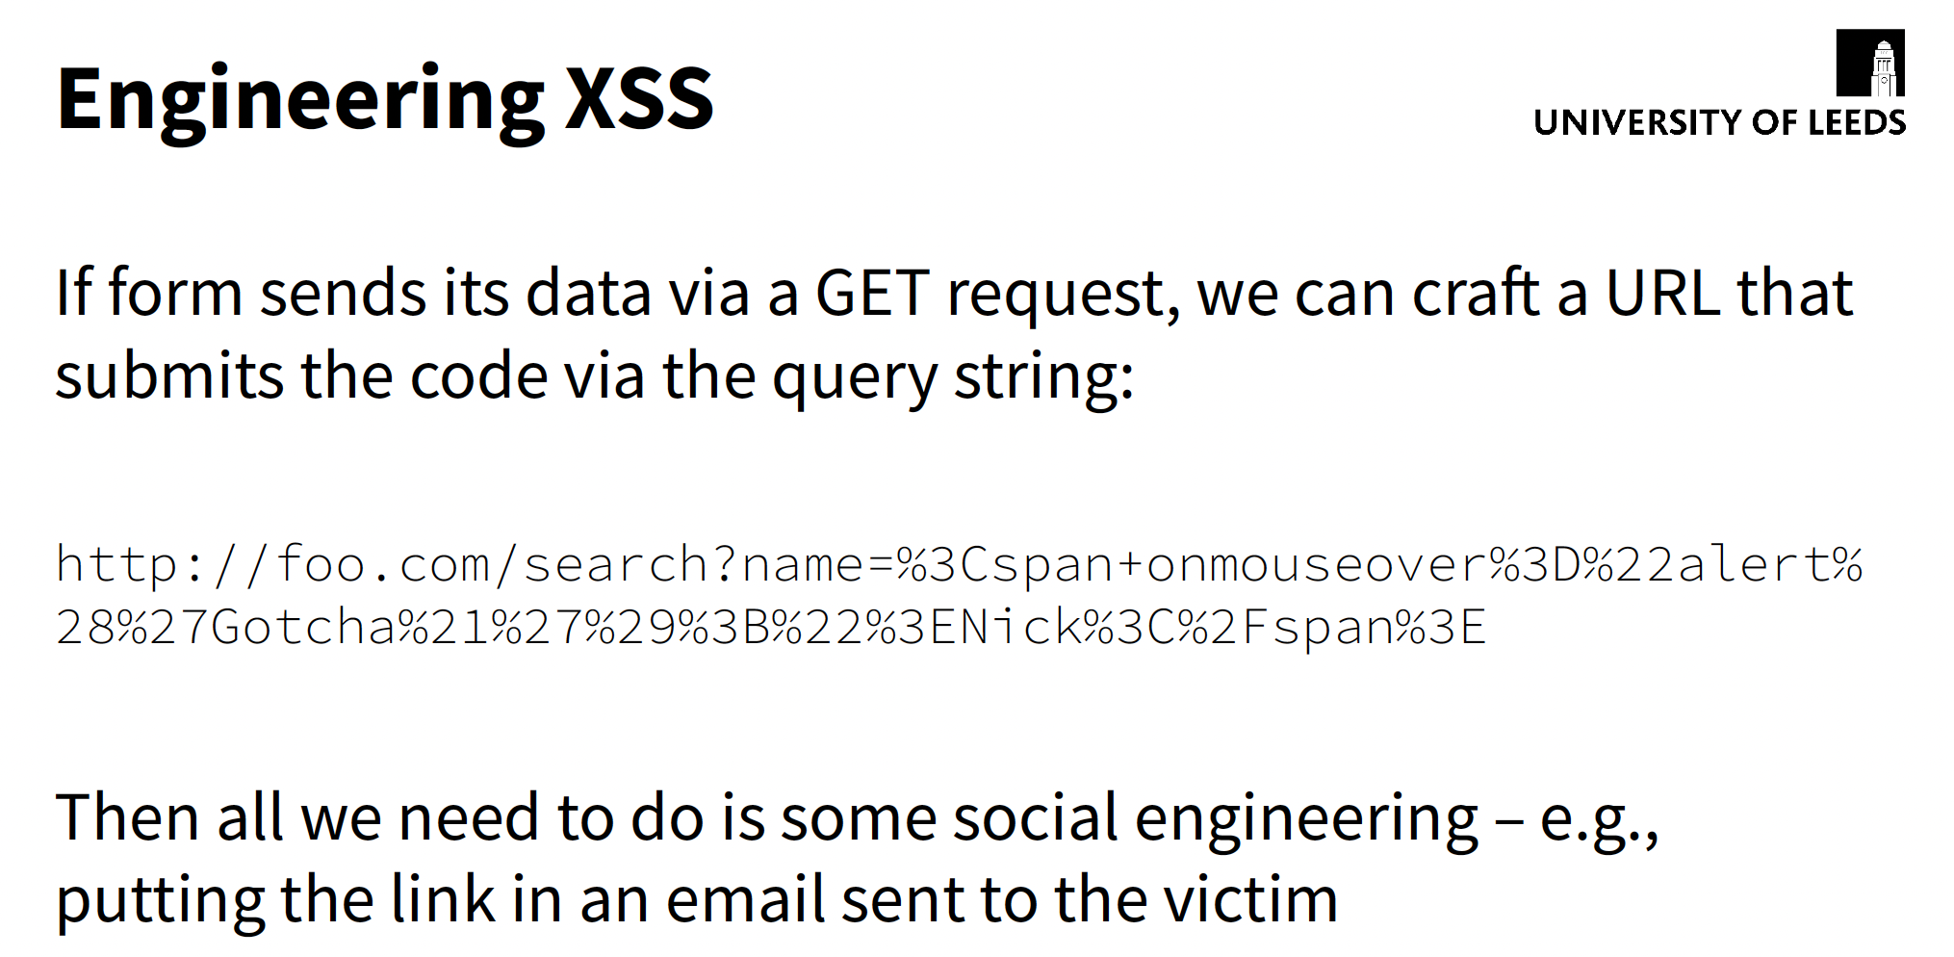

Slide 36
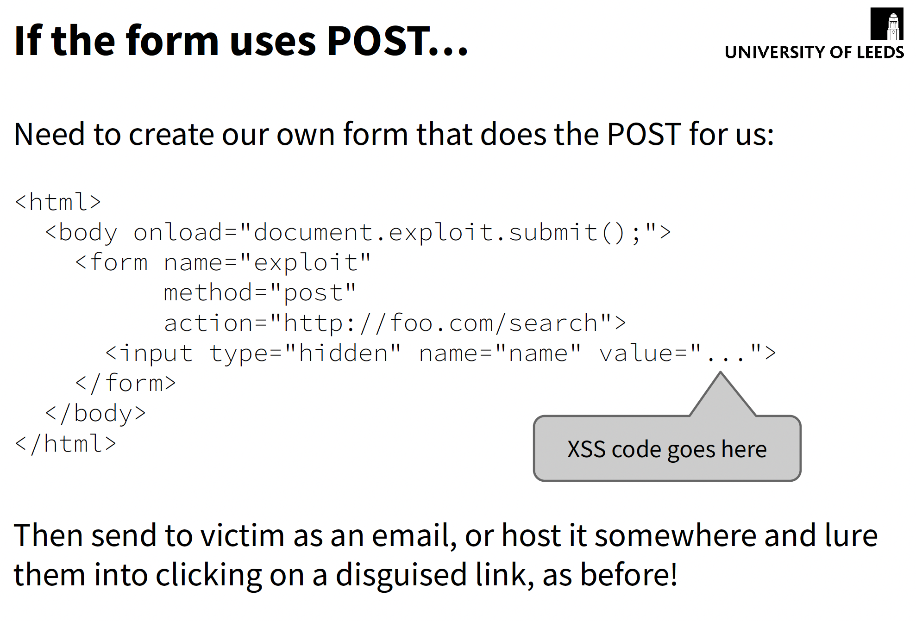

Slide 37
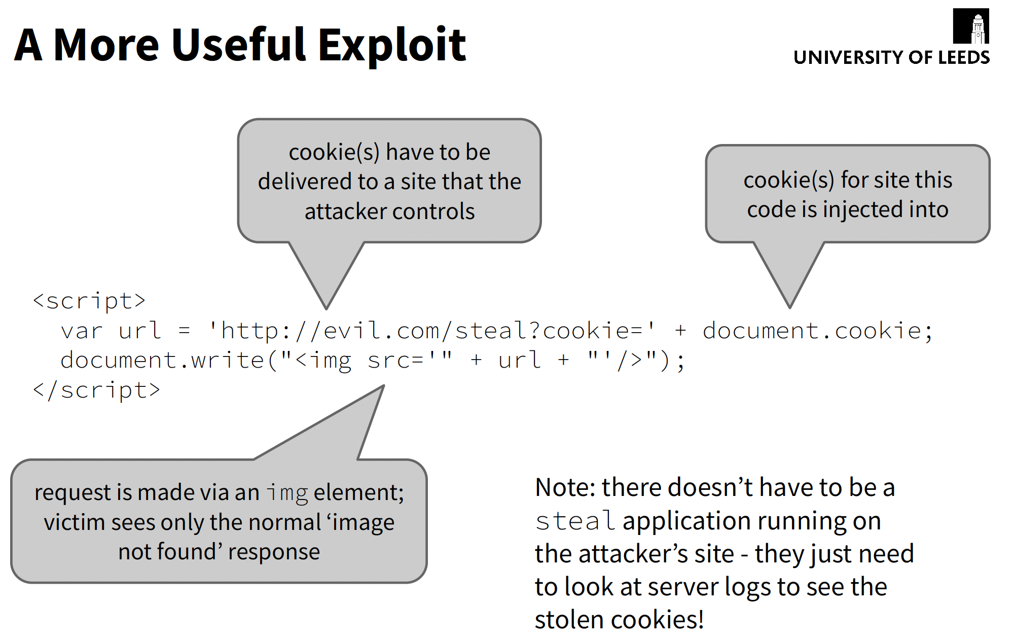

Slide 38
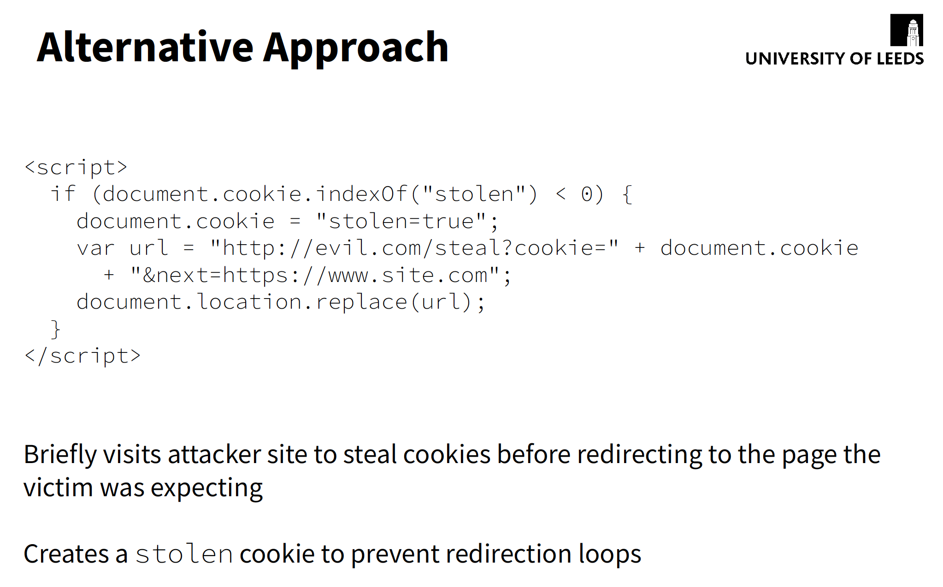

Slide 39
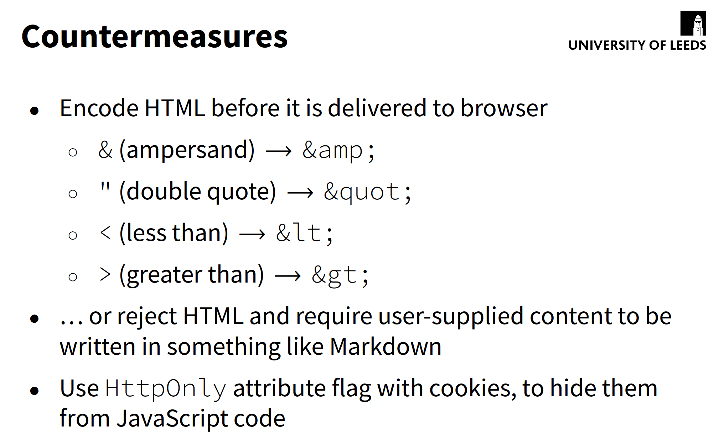

Slide 40
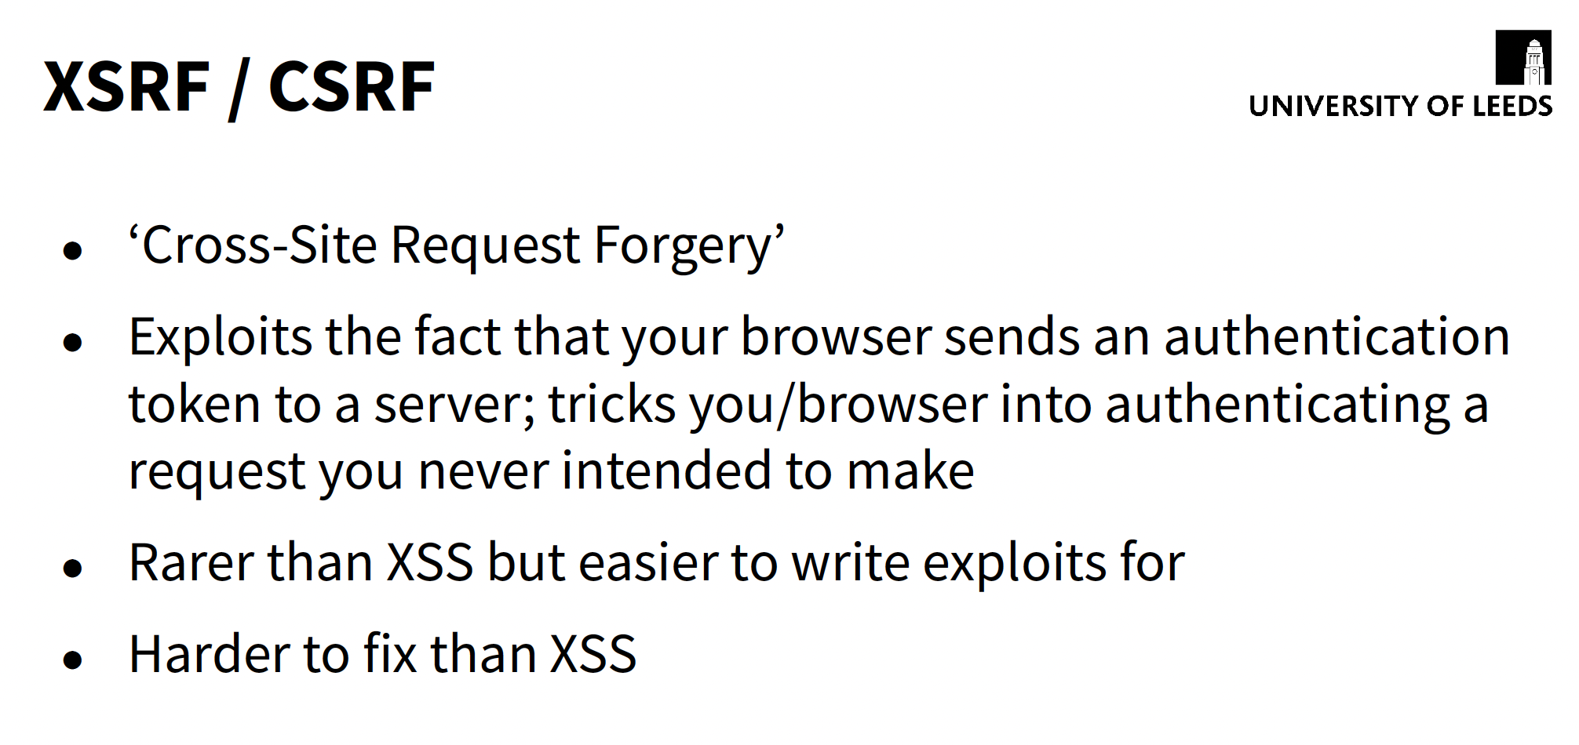

Slide 41
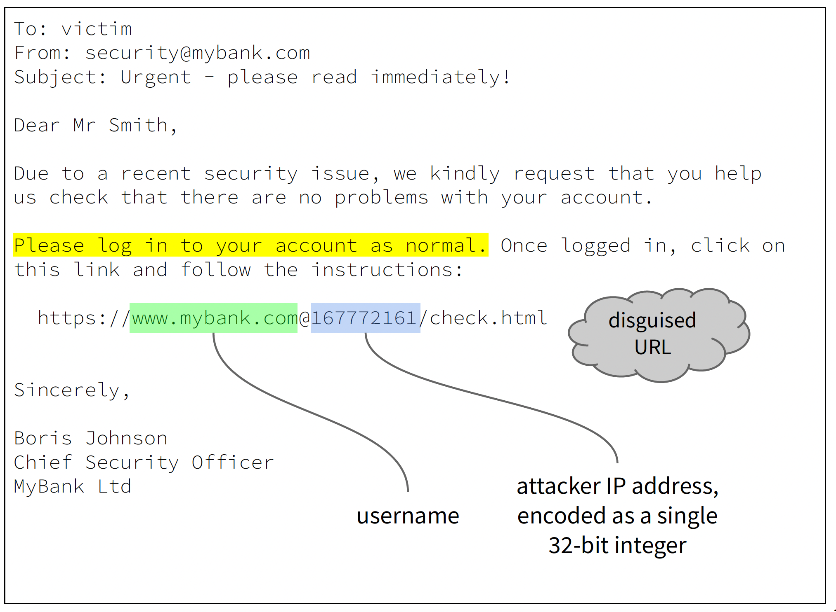

Slide 42
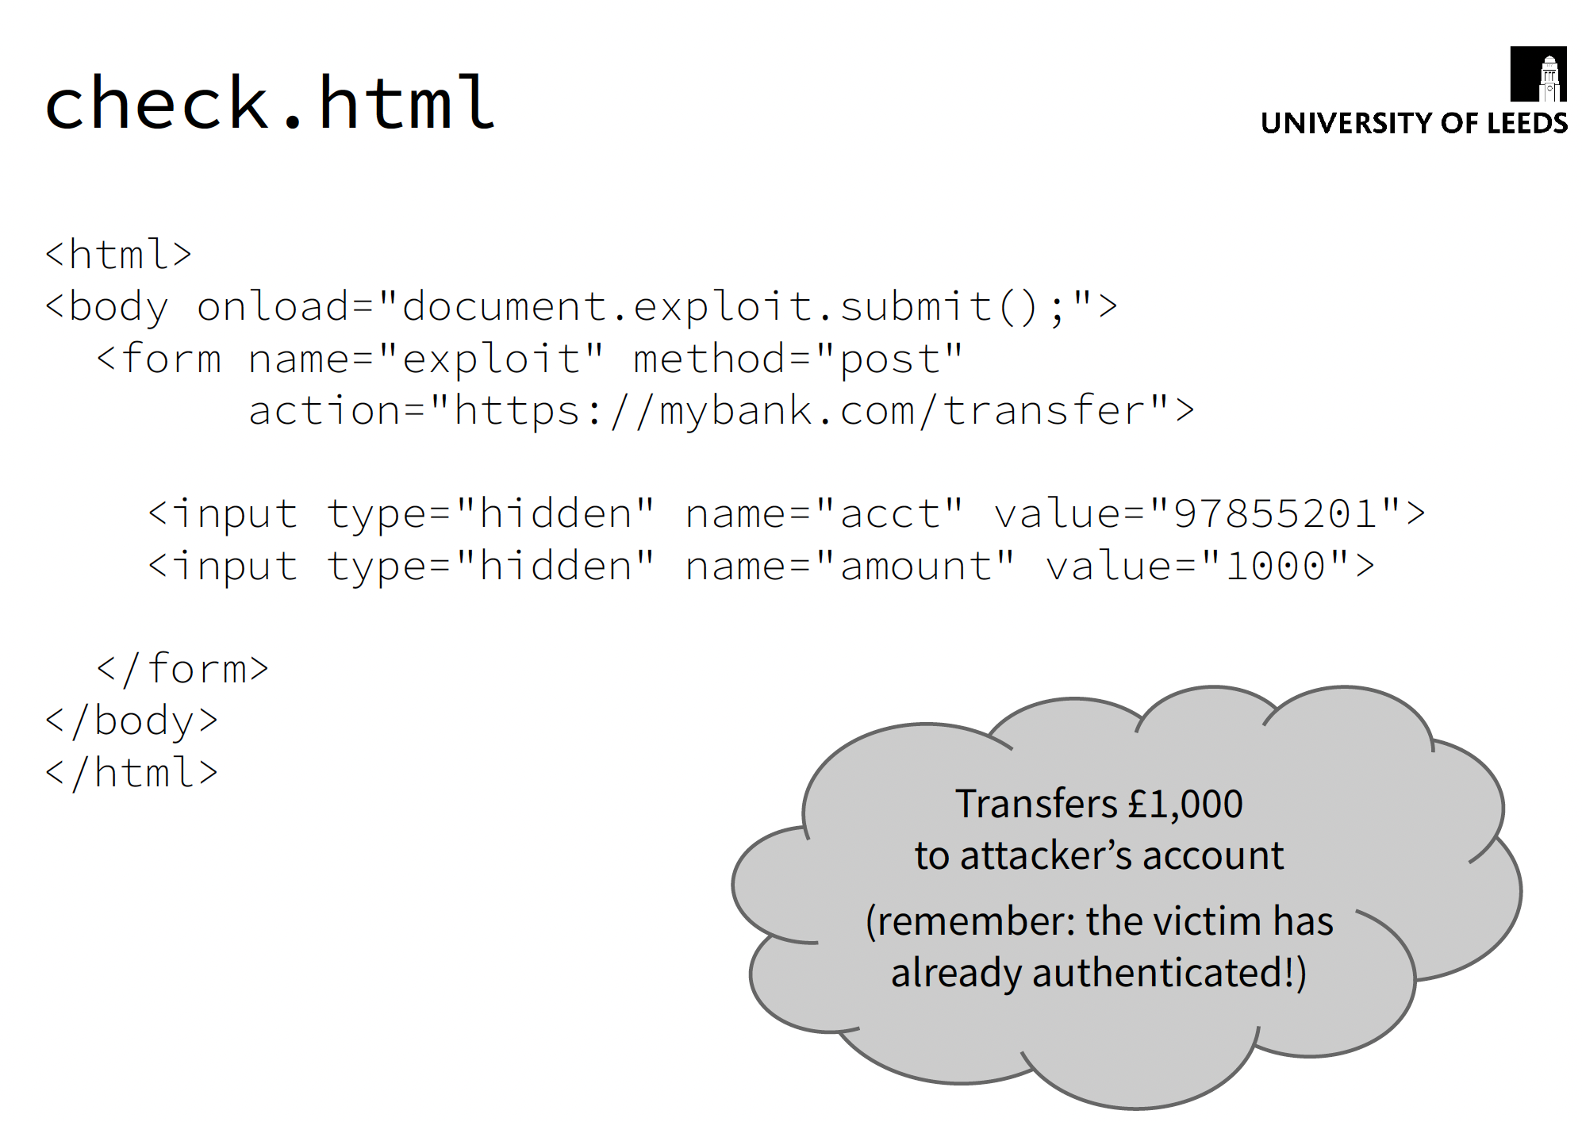

Slide 43
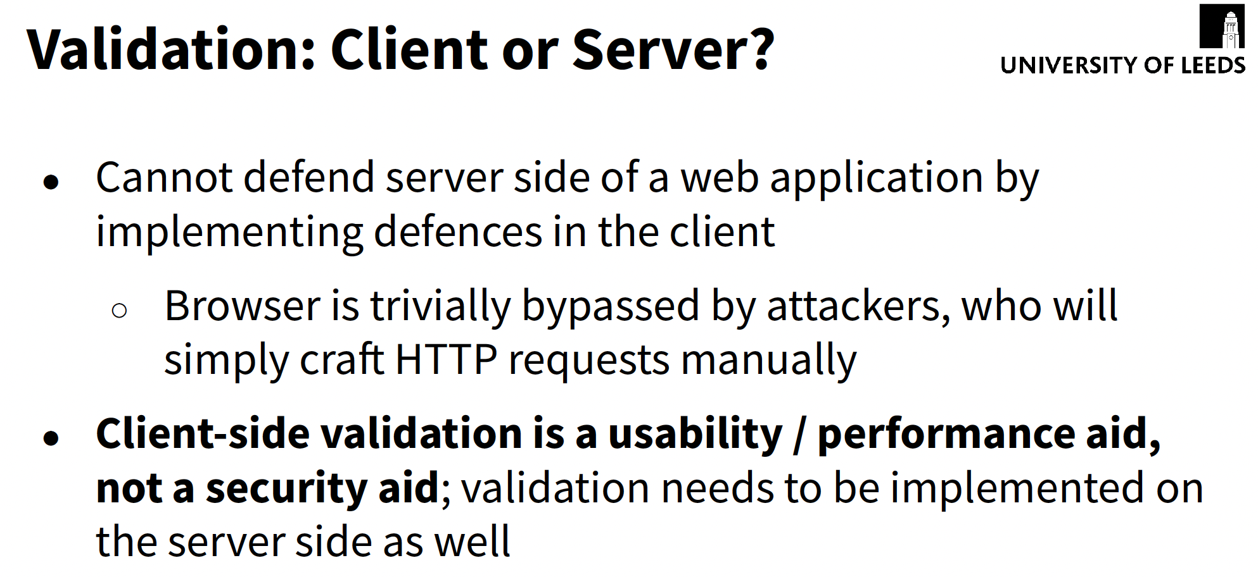

Slide 44
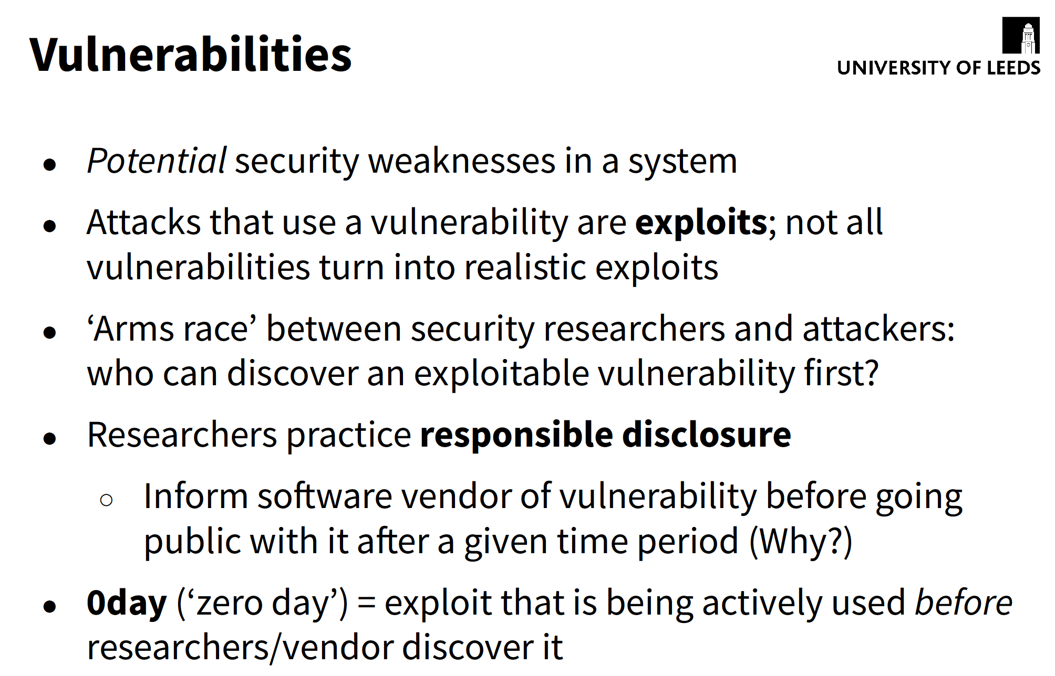

Slide 45
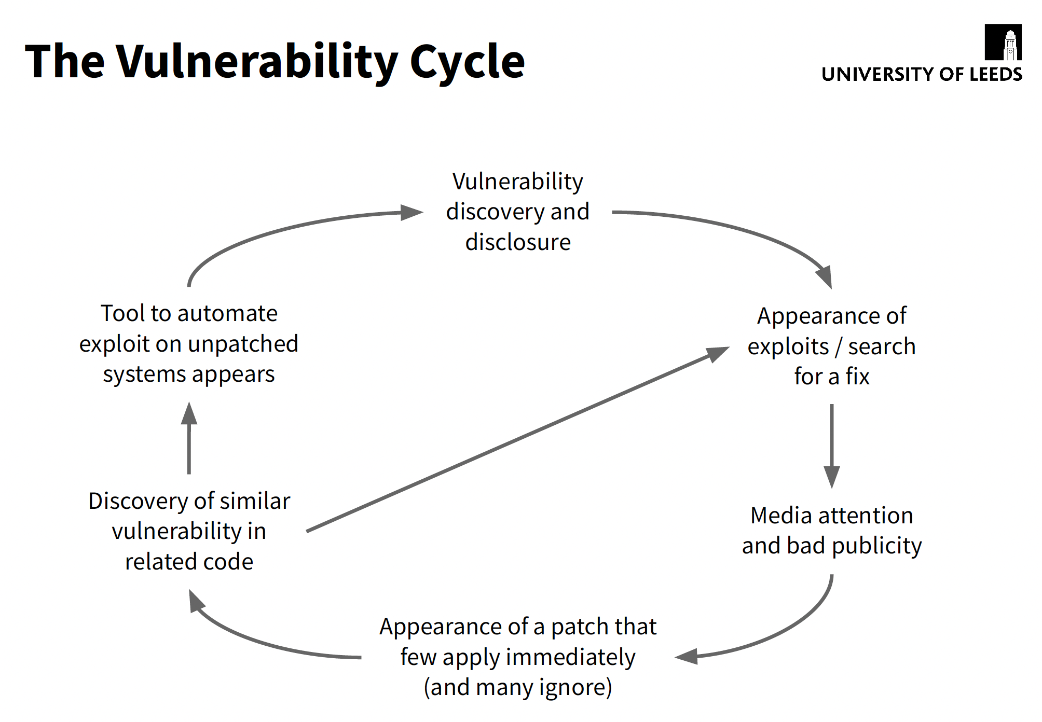

Slide 46
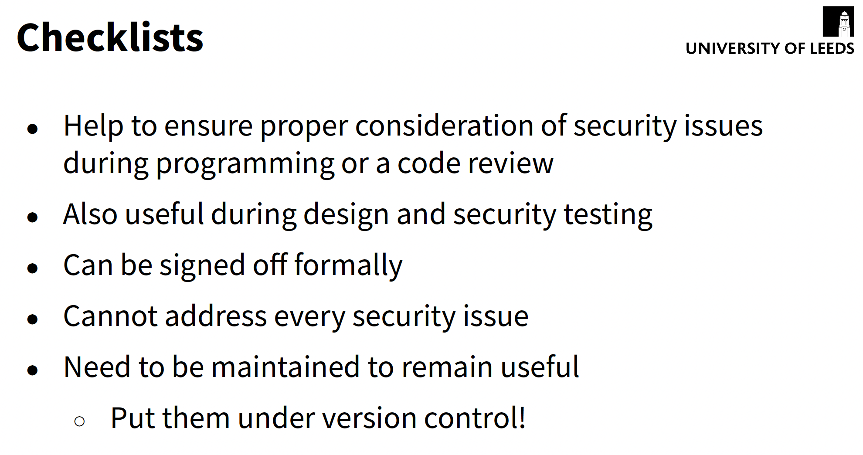

Slide 47
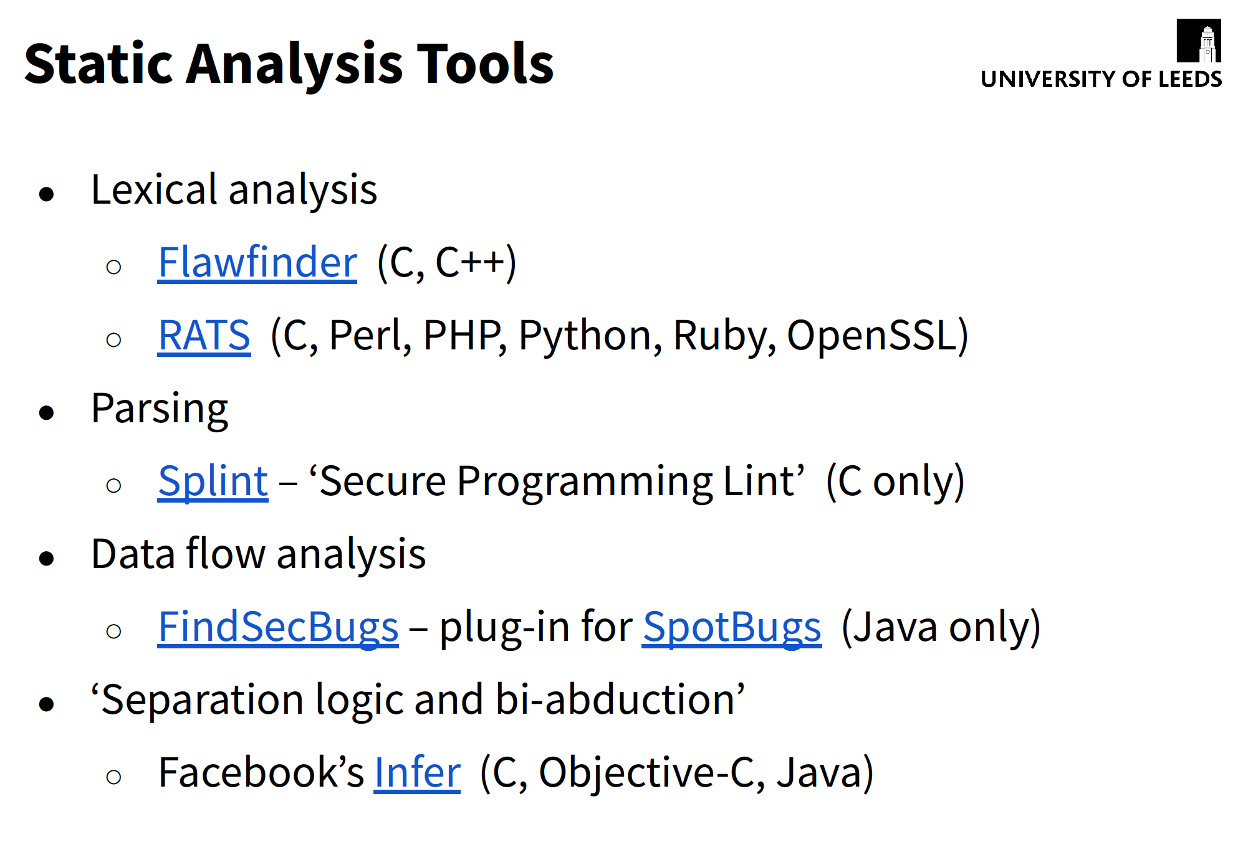

Slide 48
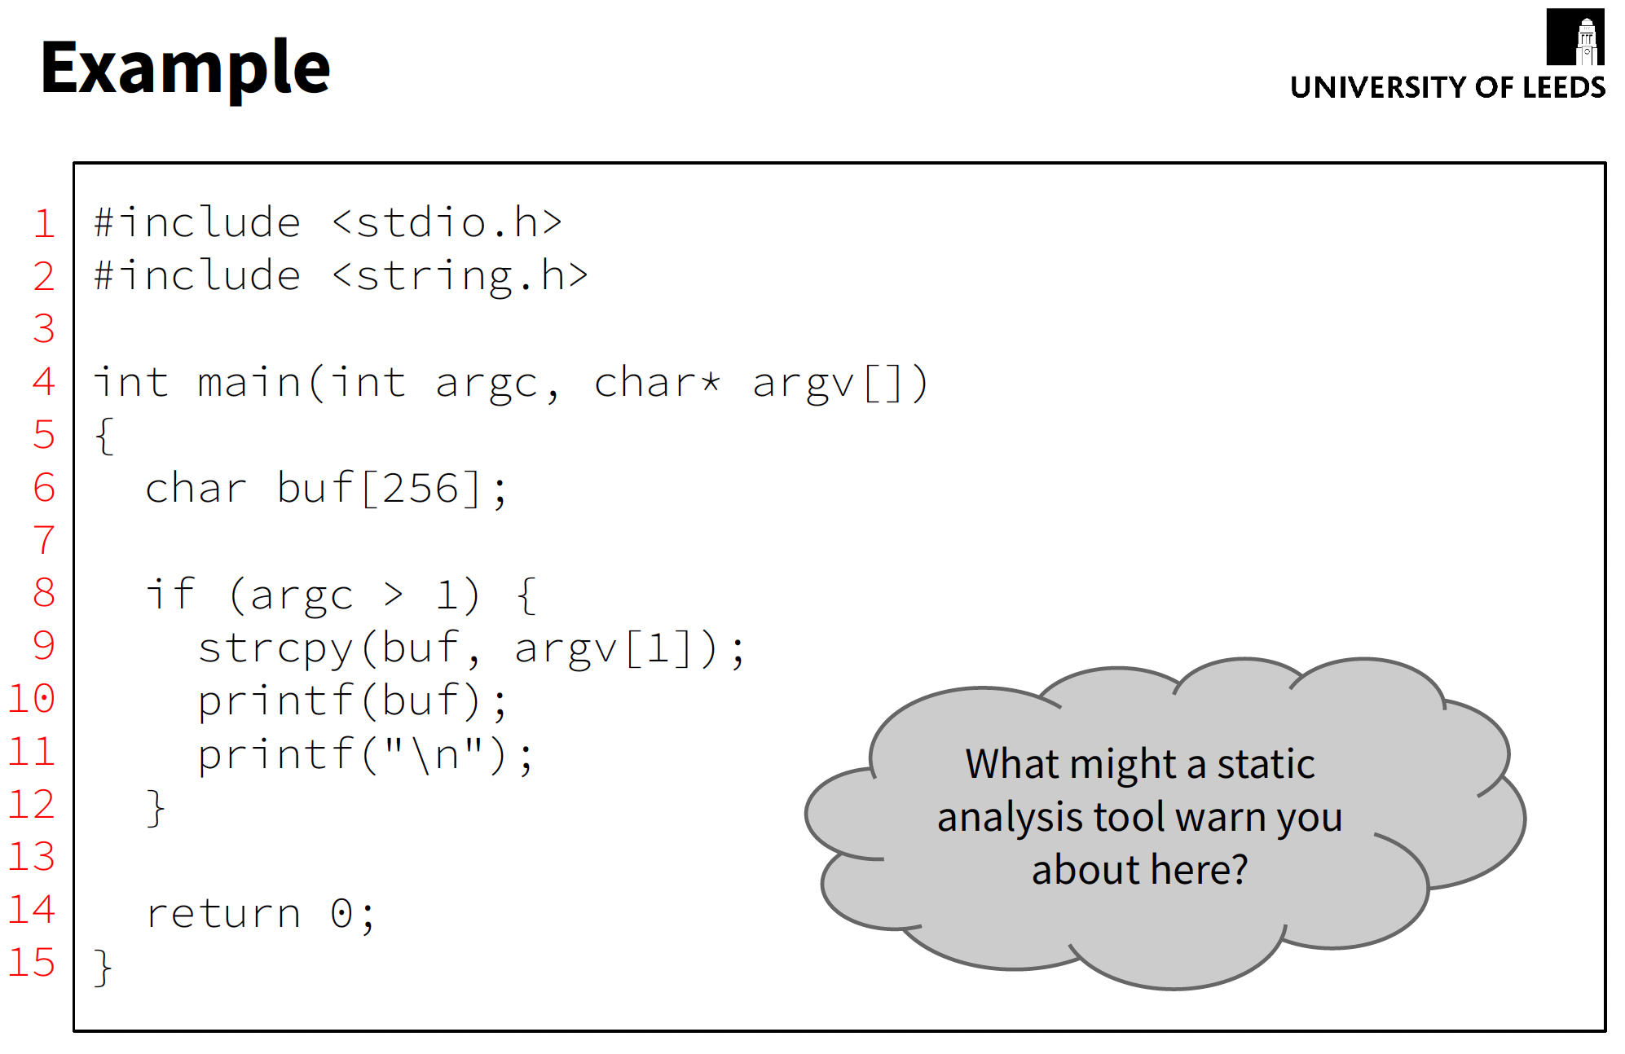

Slide 49
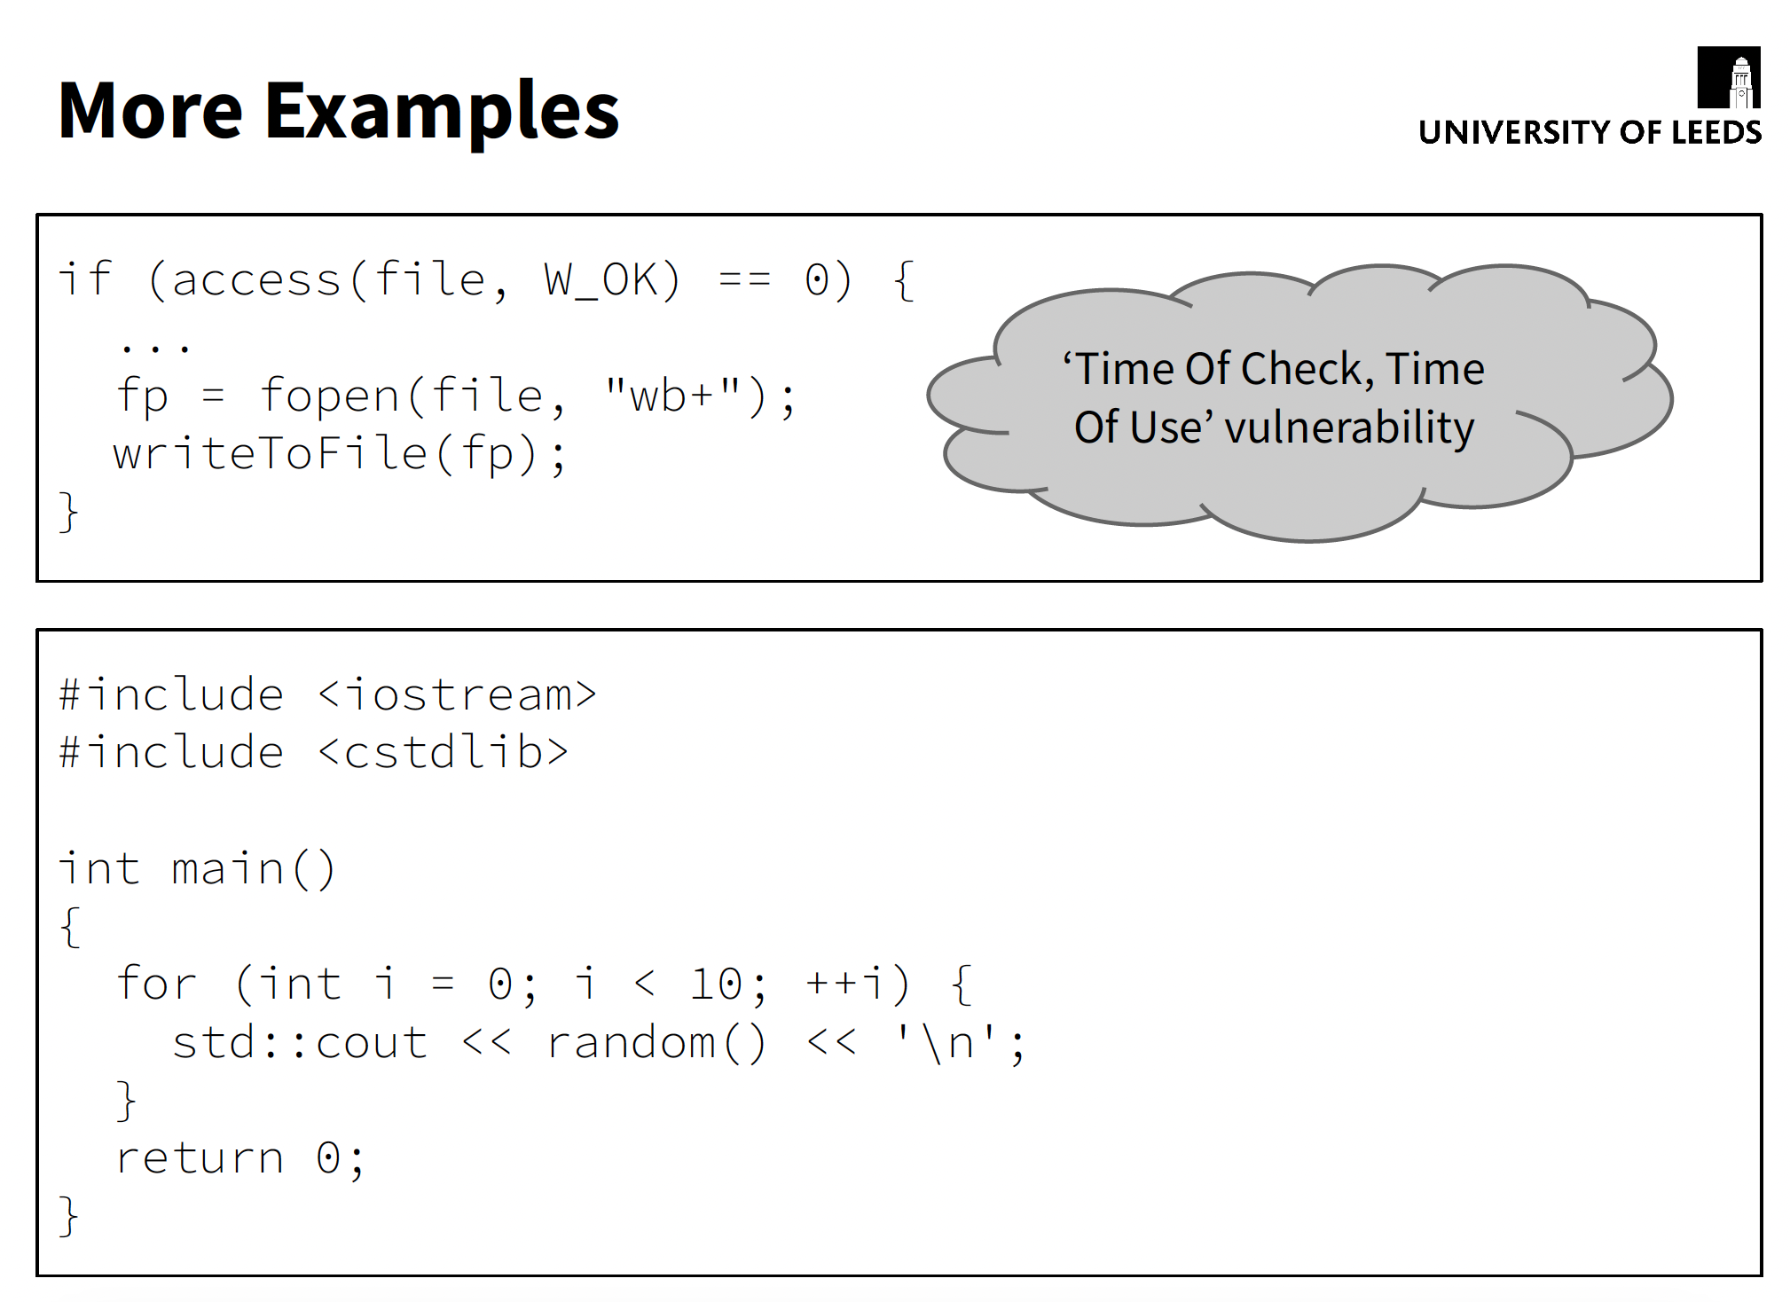

Slide 50
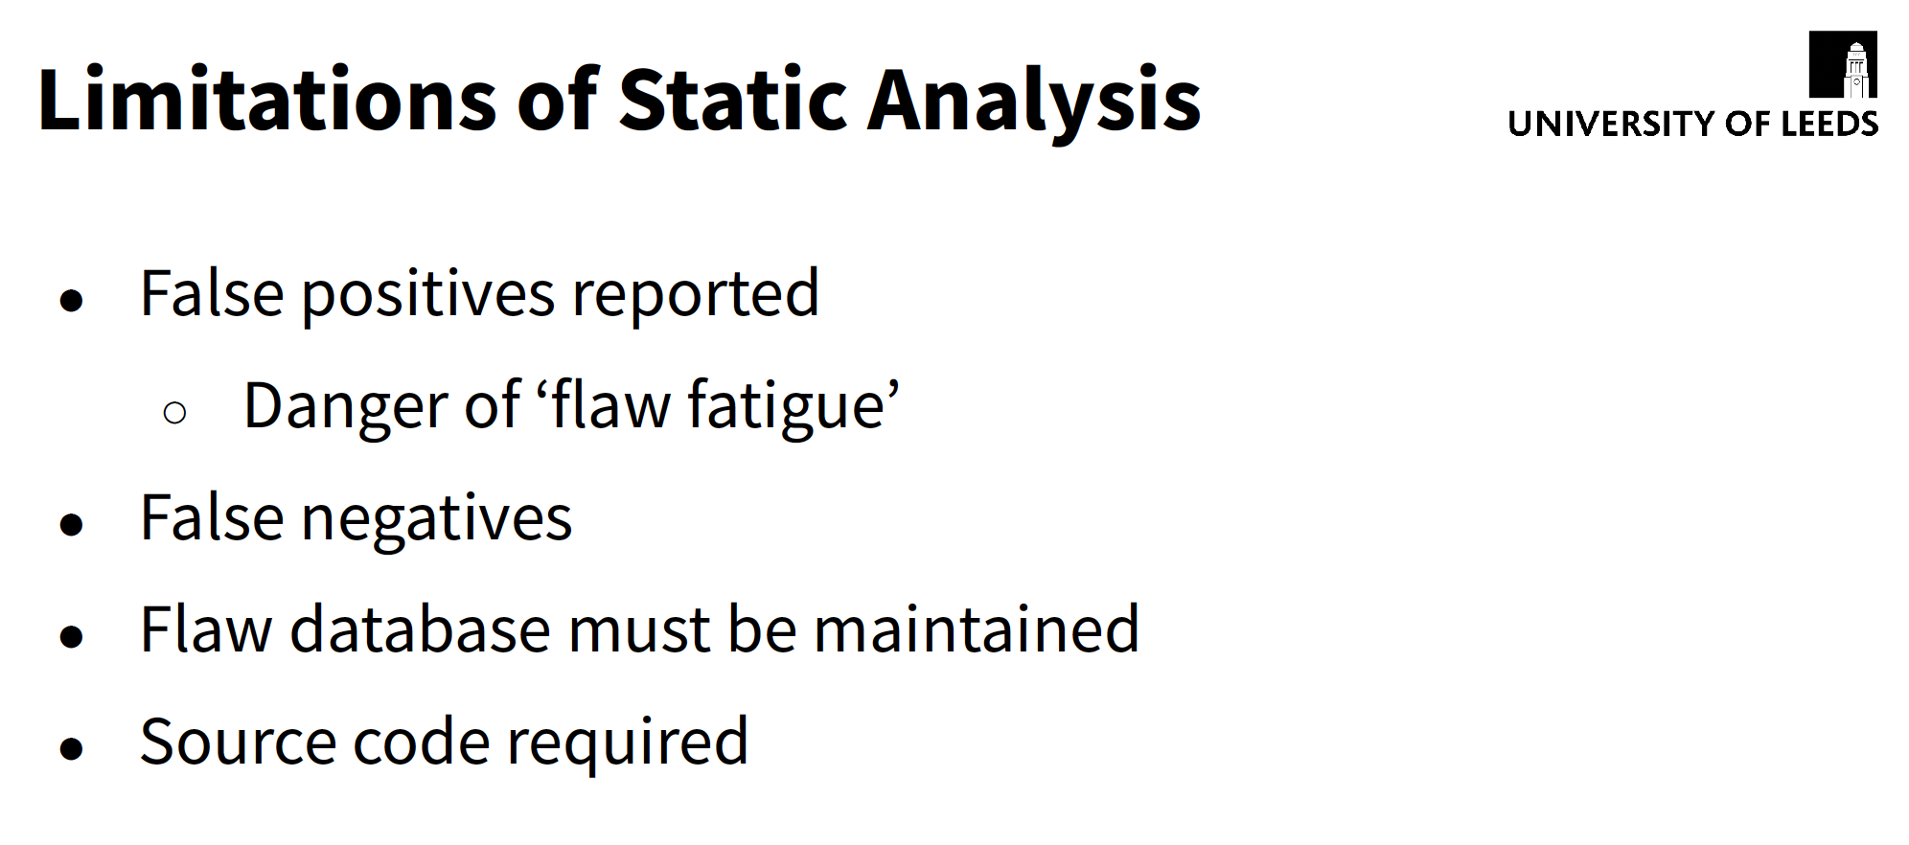

Slide 51
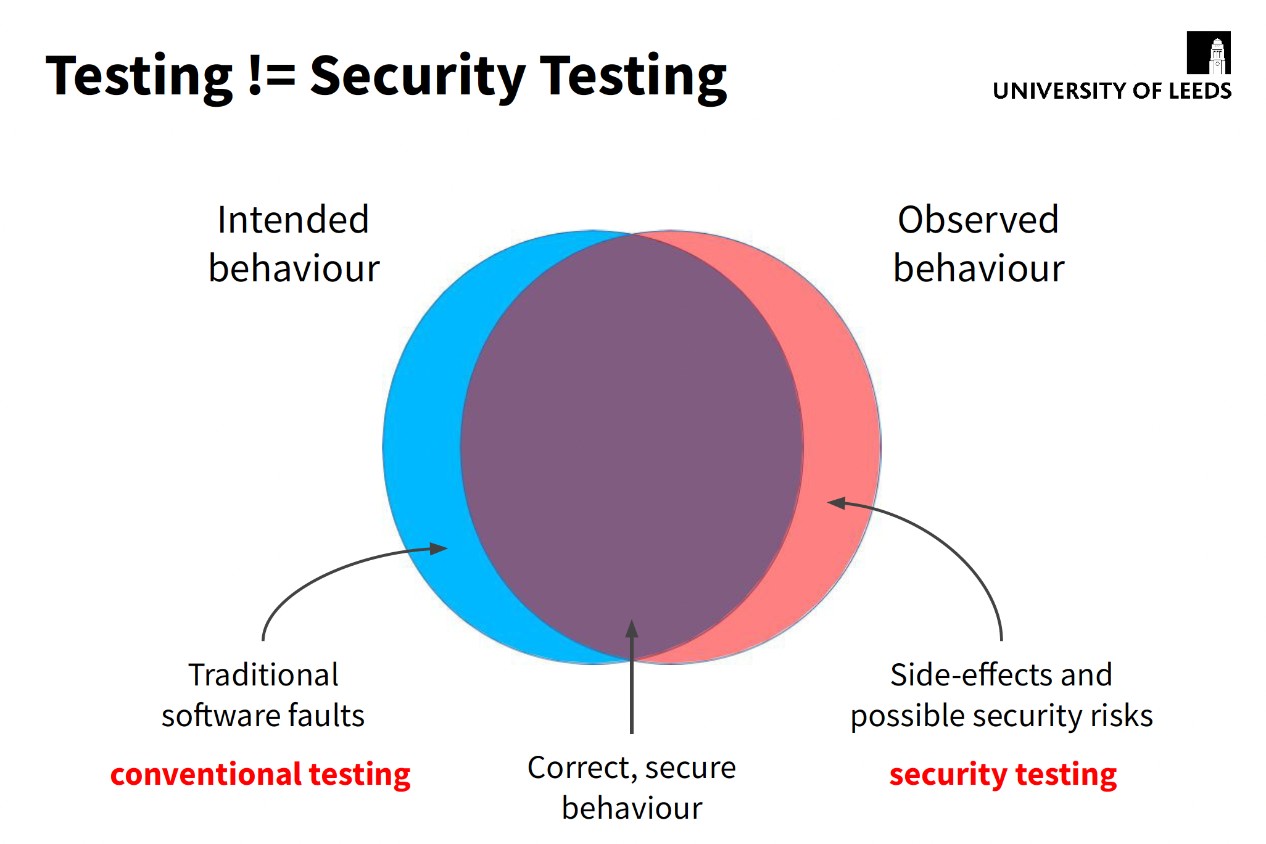

Slide 52


Slide 53


Slide 54


Slide 55


Slide 56


Slide 57


Slide 58


Slide 59


Slide 60


Slide 61


Slide 62


